Slide 1
Chemistry
Unit Two, Day Four

Slide 2
Ions
If an atom loses an electron, it becomes more positive. Positive ions are called cations.
If an atom gains an electron, it becomes more negative. Negative ions are called anions.

Slide 3
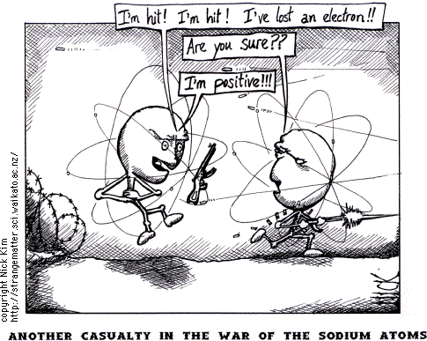

Slide 4
Reactions
In chemical reactions, there are no changes in the nuclei of the atoms, so the identities of the atoms do not change
But, in nuclear reactions, an atom of one element changes into an atom of another element. They involve a change in the atom’s nucleus

Slide 5
Nuclear Decay
Involves nucleus (protons and neutrons)
Normal reactions involve valence electrons
Radioactive isotopes – unstable due to too many neutrons
Emit particles and energy to become stable atom – changes identity of atom.

Slide 6
Fission & Fusion
Fusion: small atoms coming together to make a bigger atom
occurs on the sun; very hot temperatures
Atoms “fuse” together
Fission: breaking a large atom into smaller atoms (called daughter nuclei)
Natural radioactive decay

Slide 7
Natural Radioactive Decay
Alpha decay (α): 2 protons & 2 neutrons (He)
Least dangerous
₉₂²³⁵U → ₉₀²³¹Th + ₂⁴He
Beta decay (β or ⁰e): high speed electron
²³¹Th → ²³¹Pa + ⁰ ₋₁ e
Gamma rays (γ): energy given off
Most dangerous
Usually accompany alpha and beta radiation
** Balance both mass numbers and atomic numbers

Slide 8
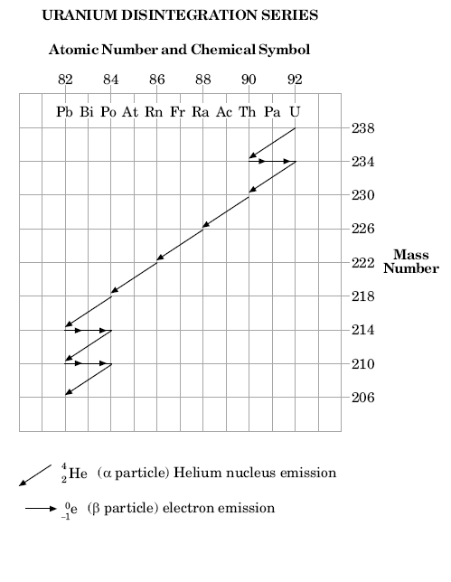
Decay Series
A radioactive isotope may have to give off many particles to finally become stable. This is called a decay series.
²³⁸U → ⁴He + ²³⁴Th
²³⁴Th → ⁰ ₋₁ e + ²³⁴ Pa

Slide 9
The other subatomic particle
Neutrons are sometimes involved in nuclear reactions.
Remember, neutrons have a mass of 1 and an atomic number of 0 (since there are no protons in a neutron)

Slide 10
Radiation at work
Kills cancer
Used to diagnose of disease
Energy production
Nuclear power plants – fission of uranium-235
Carbon dating – dating fossils (C-14 detection)
Smoke detectors
Food Irradiation

