Slide 1
Chemistry
Unit Two, Day One

Slide 2
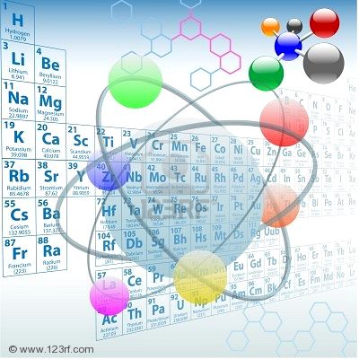
Elements can be found on the
Periodic Table

Slide 3
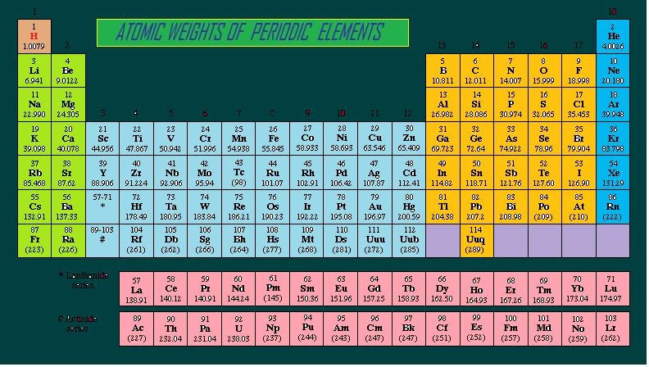

Slide 4
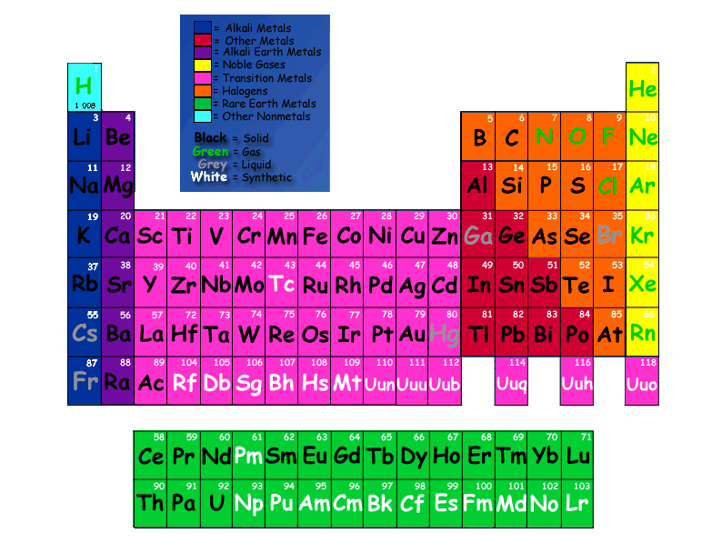
Atoms
An element is matter with a fixed composition – it is made of the same atoms
An atom is the smallest piece of matter that still retains the properties of its element.

Slide 5
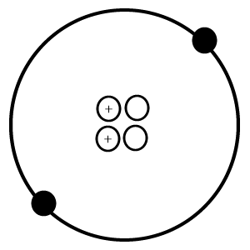
Do you know the parts of an atom?
B
A
D
C

Slide 6
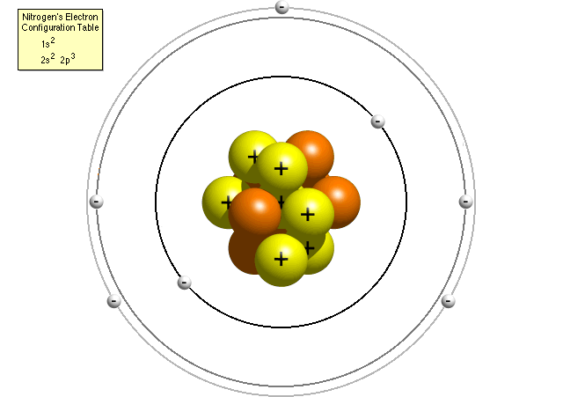
Atoms
Protons: positively charged
Neutrons: neutrally charged
Electrons: negatively charged
Protons and neutrons are found in the center of the atom - the nucleus
Electrons are found orbiting in the electron cloud surrounding the nucleus
The main particles that compose an atom are:

Slide 7
Subatomic Particle Masses & Charges
Particle | Mass (g) | Mass (atomic mass unit - amu) | Charge
Proton | 1.67 x 10⁻²⁴ | 1 | +1
Neutron | 1.67 x 10⁻²⁴ | 1 | 0
Electron | 9.11 x 10⁻²⁸ | <<1 | -1

Slide 8
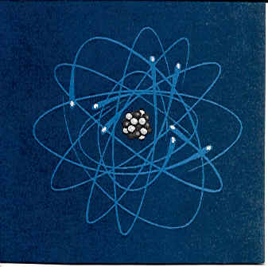
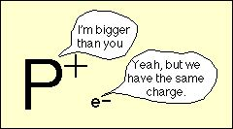
Atoms
The mass of an atom comes from particles in its nucleus
The electron is so small, it is considered negligible when finding the mass of an atom

Slide 9
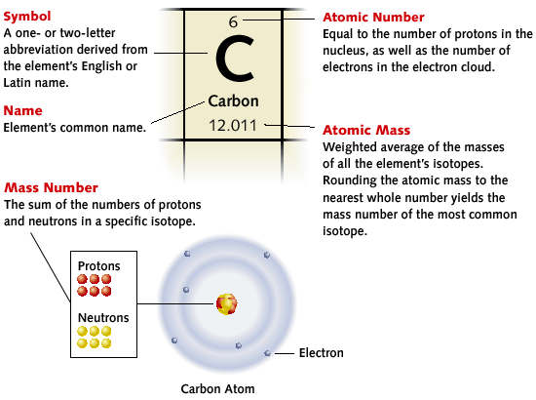
Atoms
The unit of measurement used for atomic particles is the atomic mass unit (amu)

Slide 10
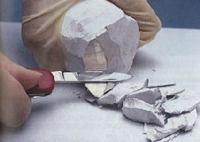
Masses of Atoms
An atom’s atomic number is equal to the number of protons in an atom
An atom’s mass number is the sum of the protons and neutrons in an atom
11
Sodium
Na 22.98976928

Slide 11
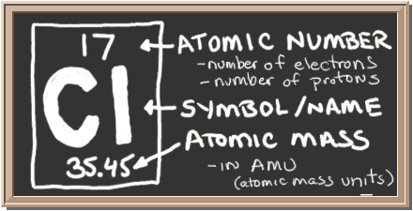
Atomic Mass
The mass of a proton or a neutron is approximately 1 amu
A chlorine atom containing 17 protons and 18 neutrons has a mass of 35 amu

Slide 12
Masses of Atoms
Copper (Cu) has an atomic number of 29 and a mass number of 64
29 amu of its mass comes from its 29 protons
The remaining 35 amu comes from its 35 neutrons
29
Cu
Copper
63.5

