Slide 1
Warm Up
Balance the following equations:
CuSO₄ + K₃PO₄ → Cu₃(PO₄)₂ + K₂SO₄
3CuSO₄ + 2K₃PO₄ → Cu₃(PO₄)₂ + 3K₂SO₄
C₆H₁₂O₆ + O₂ → H₂O + CO₂
C₆H₁₂O₆ + 6O₂ → 6H₂O + 6CO₂

Slide 2
The 5 Types of Chemical Reactions
Reactions, Day Two

Slide 3
Diatomic Molecules!
Diatomic molecules contain two atoms.
Seven elements exist as diatomic molecules at room temperature.
H₂, N₂, O₂, F₂, Cl₂, Br₂, I₂
These seven elements will never be alone. If only the element is there, you must put a 2 subscript.
It is still possible for there to be only one of these elements, if it is bonded to something else.
Example: MgO

Slide 4
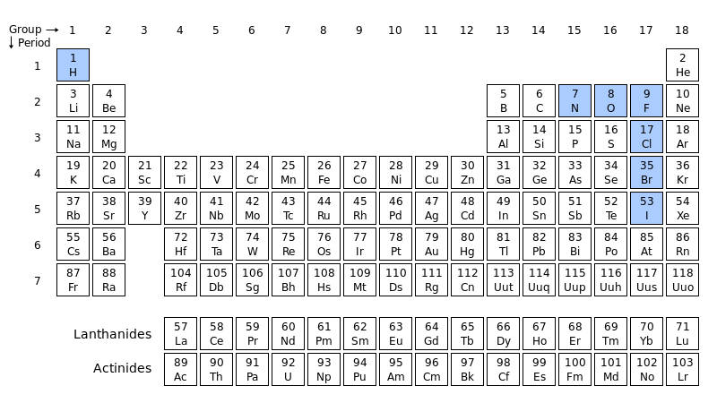

Slide 5
Each group should have 4 people and 20 cards. Split the cards up so each person has 5.
On your own piece of paper, write out your 5 chemical equations and balance them.
Then, once all equations are balanced, look at the 20 as a group. You need to split the 20 cards up in to 5 different reaction types.
Everyone in the group should be able to defend your 5 types and explain why the cards are split up as they are.
When you can all defend it, call me over to be checked.
If you’re right, I will help you look up the names of the different types of reactions.
Using those names, label each of the 5 reactions you balanced with its type.
Everything will be stapled together and turned in for a group grade (so help each other and work together!!).

Slide 6
Five types of reaction
Single Replacement
Double Replacement
Synthesis
Decomposition
Combustion

Slide 7
Synthesis
Two things combine to make a completely new compound.
Two reactants on the left and only one product on the right.
2Na + Cl₂ ➔ 2NaCl

Slide 8
Decomposition
Something breaks apart into individual pieces.
One reactant splits into two products.
2H₂O₂ ➔ 2H₂O + O₂

Slide 9
Single Replacement
One “kicks” out the less reactive element.
Two reactants and two different products.
On each side (reactant and product) there is one single element and one compound.
2Al + Fe₃N₂ ➔ 3Fe + 2AlN

Slide 10
Double Replacement
Two elements trade places or “partners” with each other.
Two reactants and two different products.
2BF₃ + 3Li₂SO₃ ➔ B₂(SO₃)₃ + 6LiF

Slide 11
Combustion
A Carbon containing compound reacts with oxygen.
Carbon dioxide and water are always your products!
C₆H₁₂O₆ + 6O₂ ➔ 6H₂O + 6CO₂

Slide 12
Practice
Pb(NO₃)₂ + KI → PbI₂ + KNO₃
Pb(NO₃)₂ + 2KI → PbI₂ + 2KNO₃ Double Displacement
HgO → Hg + O₂
2HgO → 2Hg + O₂ Decomposition
C₁₀H₈ + O₂ → CO₂ + H₂O
C₁₀H₈ + 12O₂ → 10CO₂ + 4H₂O Combustion
Na + Cl₂ → NaCl
2Na + Cl₂ → 2NaCl Synthesis

Slide 13
Word Problems
Things you must know!!
Be able to write formulas from names!
Common chemical names (water, ammonia)
Diatomics (H₂, N₂, O₂, F₂, Cl₂, Br₂, I₂)
Symbols for the states of matter (if given)
Reactants and products

Slide 14
Quick Review. Write the formula from following:
Carbon Dioxide
CO₂
Magnesium hydroxide
Mg(OH)₂
Lead (IV) oxide
PbO₂
Iron (III) Nitrate
Fe(NO₃)₃

Slide 15
Example
Hydrogen gas will react with oxygen gas to produce water.
H₂ + O₂ → H₂O
2H₂ + O₂ → 2H₂O
Phosphoric Acid reacts with magnesium hydroxide to form magnesium phosphate and water.
H₃PO₄ + Mg(OH)₂ → Mg₃(PO₄)₂ + H₂O
2H₃PO₄ + 3Mg(OH)₂ → Mg₃(PO₄)₂ + 6H₂O

Slide 16
Practice
Magnesium metal reacts with Chlorine gas to produce Magnesium Chloride
Mg _{(s)} + Cl_{2 (g)} →MgCl_{2 (s)}
Nitrogen gas reacts with hydrogen gas to form ammonia
N_{2 (g)} + 3H_{2 (g)} →2NH_{3 (g)}
Sodium metal reacts violently with water to produce sodium hydroxide and hydrogen gas.
2Na _{(s)} + 2H₂O _{(l)} → 2NaOH _{(aq)} + H_{2 (g)}

