Slide 1
Warm-up – Discuss with someone around you instead of writing it down.
What did Dalton’s atomic theory propose that we no longer believe today?
Does that mean Dalton was a bad scientist?
All matter is made up of atoms.
Atoms are extremely small and indivisible (can’t be broken up).
All atoms of an element are exactly the same and atoms of different elements are different.
Elements combine in simple, whole number ratios to form compounds.

Slide 2
Warm-up
How can we calculate the number of protons, neutrons, and electrons given the atomic number and mass number??
If Carbon has an atomic mass of 13, how many of each subatomic particle does it have?

Slide 3
Isotopes
Atomic Theory, Day Two
6 September 2013

Slide 4
John Dalton’s Atomic Theory
All matter is made up of atoms.
Atoms are extremely small and indivisible.
All atoms of an element are exactly the same and atoms of different elements are different.
Elements combine in simple, whole number ratios to form compounds.

Slide 5
In summary…
Democritus and the idea of “atomos”
John Dalton’s atomic theory (indivisible and identical)
J.J. Thomson discovers the electron
Robert Millikan’s oil drop experiment fixes the charge and mass of the electron
Ernest Rutherford’s gold foil experiment leads to the nuclear model
James Chadwick discovers the neutron
A study of light leads Neils Bohr to the idea of energy levels for electrons
Planck and Einstein realize there are energy levels
Schrödinger hypothesized that electrons act like waves as well as particles

Slide 6
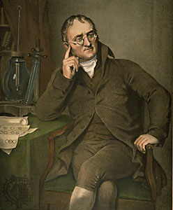
Something to think about…
What did Dalton’s atomic theory propose that we no longer believe today?
Does that mean Dalton was a bad scientist?

Slide 7
Now, on to Isotopes!!

Slide 8
Masses of Atoms
Atoms of the same element can have different numbers of neutrons
These are isotopes
Isotopes are identified by the name of the element followed by its mass number

Slide 9
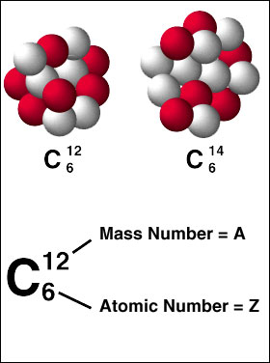
Masses of Atoms
Carbon-12 has 6 protons and 6 neutrons
Carbon-14 has 6 protons and 8 neutrons
The average atomic mass of an element is the weighted average mass of the element’s isotopes

Slide 10
Here are three isotopes of an element:
₆¹²C ₆¹³C ₆¹⁴C
The element is: __________________
The number 6 refers to the _________________________
The numbers 12, 13, and 14 refer to the ________________________
How many protons and neutrons are in the first isotope? _________________
How many protons and neutrons are in the second isotope? _________________
How many protons and neutrons are in the third isotope? _________________

Slide 11
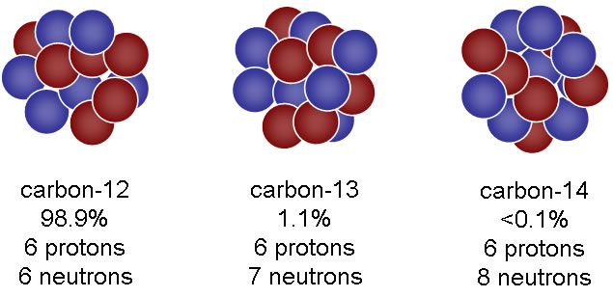
How can we find the average atomic mass of these three isotopes of carbon?

Slide 12
Average Atomic Mass!!
Take your percent abundance of each isotope and divide it by 100 (to take it out of % and turn it in to a decimal).
Multiply this decimal by the mass number of the corresponding isotope (for each isotope).
Add all of these together.

Slide 13
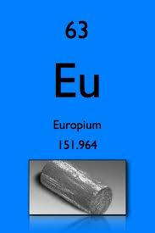
Example Problem
Naturally occurring europium (Eu) consists of two isotopes was a mass of 151 and 153. Europium-151 has an abundance of 48.03% and Europium-153 has an abundance of 51.97%. What is the average atomic mass of europium?

Slide 14
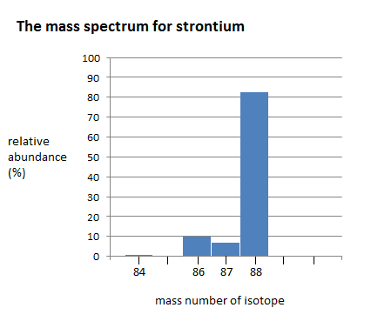
Strontium consists of four isotopes with masses of 84 (abundance 0.50%), 86 (abundance of 9.9%), 87 (abundance of 7.0%), and 88 (abundance of 82.6%). Calculate the atomic mass of strontium.

Slide 15
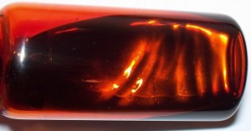
Problem
A student looked up the naturally occurring isotopes of bromine and found the following information:
50.54% of the naturally occurring isotopes of bromine have an atomic mass of 79 amu
49.46% of the naturally occurring isotopes of bromine have an atomic mass of 81 amu.
Calculate the average atomic mass of bromine.

Slide 16
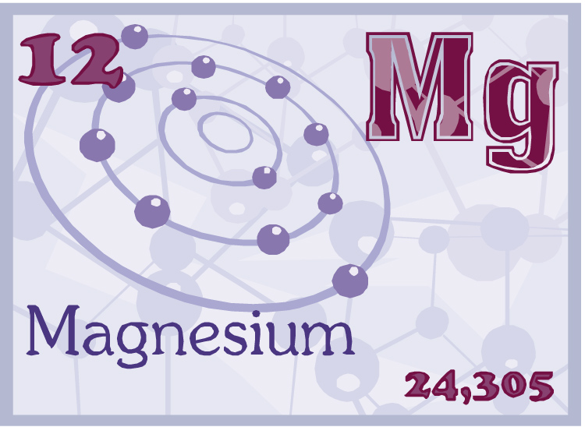
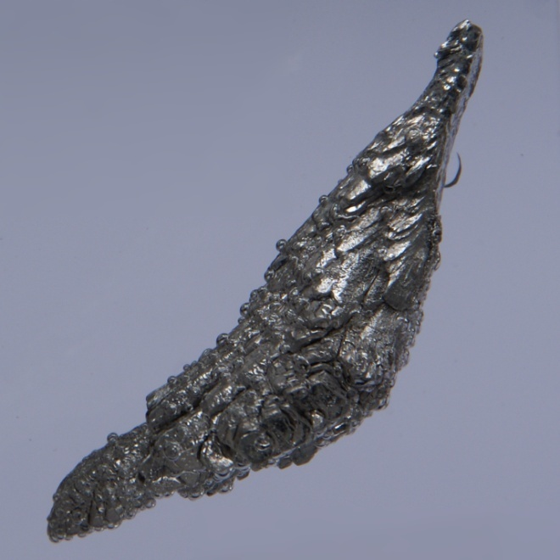
Using the following data, calculate the average atomic mass of magnesium
Mg – 24 Percent abundance: 78.70%
Mg – 25 Percent abundance: 10.13%
Mg – 26 Percent abundance: 11.17%

Slide 17
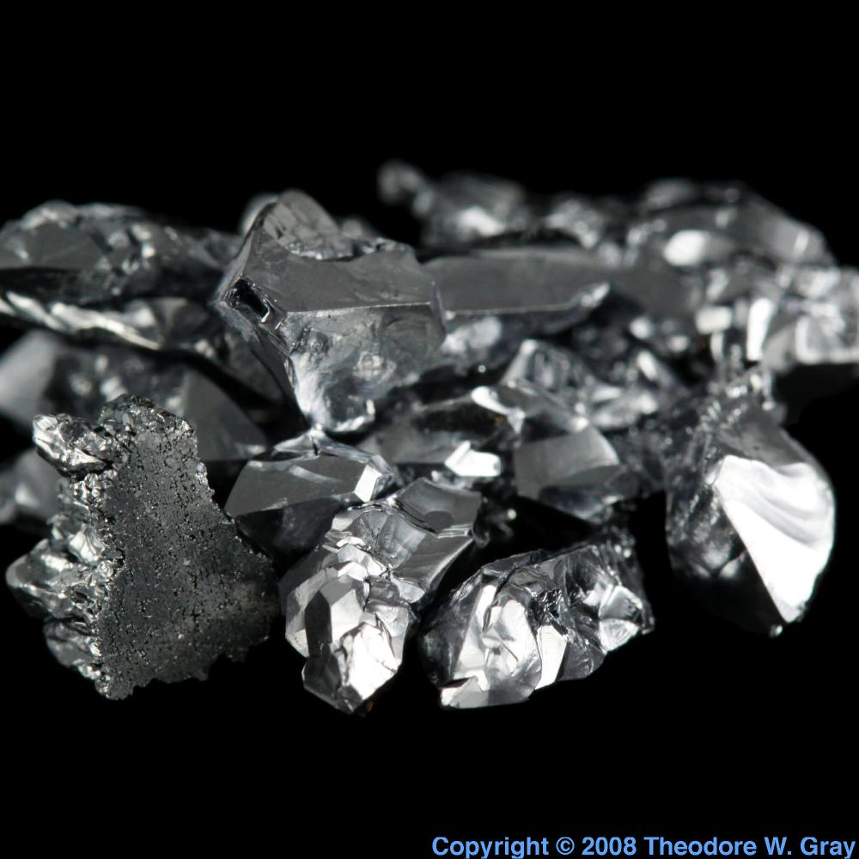
Calculate the atomic mass of silicon. The three silicon isotopes have atomic masses and relative
abundances of 28 amu (92.2297%), 29 amu (4.6832%) and 30 amu (3.0872%).

Slide 18
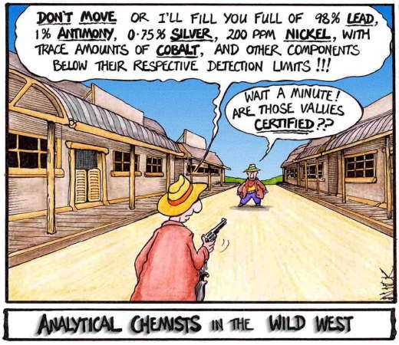
Challenge
Antimony has two naturally occurring isotopes: Antimony-121 and antimony-123. Using the average mass from the periodic table, find the abundance of each isotope. (Remember that the sum of the two abundances must be 100).

Slide 19
Arsenic’s average atomic mass is 74.92160. Find the percent abundances of arsenic’s two isotopes: Arsenic – 73 and Arsenic – 75.

Slide 20
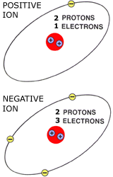
Ions
If an atom loses an electron, it becomes more positive. Positive ions are called cations.
If an atom gains an electron, it becomes more negative. Negative ions are called anions.

Slide 21
