Slide 1
Warm-up
For the following elements, tell their number of valence electrons and their most likely oxidation number (charge)
Bromine
Barium
Phosphorus
Lithium
Sulfur

Slide 2
The Periodic Table
Unit Three, Day Eight

Slide 3
You Try
Determine the charges of the following ions.
Oxygen
Sodium
Aluminum

Slide 4
Now, Periodic Table Trends
Scientists involved with making the periodic table:
Mendeleev – Came up with the first Periodic Table
Arranged elements by increasing ATOMIC MASSES (Not quite right)
Moseley
Revised Mendeleev’s table and gave us the one we use today
Elements arranged by increasing ATOMIC NUMBERS!

Slide 5
Periodic Table
Organized by elements’ atomic numbers so that those with similar properties line up in the same columns.
Period – horizontal row – tells the energy level electrons live in. Numbered 1 - 7
Group – vertical column – matches number of valence electrons in the Representative elements (“A” groups)

Slide 6
Metals
Left side of staircase
Malleable, ductile, shiny, conduct electricity and heat
Lose electrons to become positively charged (cations) when reacting and bonding
Lose enough electrons to achieve the electron configuration of a noble gas

Slide 7
Non-metals
Right side of table
Brittle and do not conduct electricity/heat
Gain electrons to become negatively charged (anions) when reacting and bonding
Gain enough electrons to achieve the electron configuration of a noble gas

Slide 8
Metalloids
Along stair step line dividing metals and non-metals
Have some metallic and some non-metallic properties

Slide 9
Some groups you need to know
Alkali Metals: First Column
Alkaline Earth Metals: Second Column
Transition Metals: D-block group
Halogens: Column 17
Noble Gases: Column 18

Slide 10
Review
Name the element in period 5 group 10.
What are the group 17 elements known as?
List two properties of non-metals.
Mg is in what group?
Is boron a metal, non-metal, or metalloid?

Slide 11
Some Definitions
Atomic Radius: Size of the neutral element’s atom
Ionization energy: The energy required to pull an electron from an atom
Electronegativity: The desire an atom has for an electron

Slide 12
Atomic Radius
Decreases as you go to the right and increases as you go down the periodic table.
Going down in a group makes sense. You’re adding an entire energy level.
When moving to the right, you are adding electrons and protons, which increases the charge. The electrons are pulled closer to the nucleus, so the atom gets smaller.

Slide 13
Ionization Energy
**Energy required to pull an electron from an atom
Increases as you go to the right and up the periodic table.
It doesn’t take much energy to pull electrons from alkali metals, since they want to give them away. And it takes lots of energy to pull electrons from noble gases, since they are so happy with their full outer shell.

Slide 14
Electronegativity
** The desire an atom has for an electron
Increases as you go to the right and up the periodic table.
Alkali metals have low electronegativity. They don’t want electrons but instead want to get rid of some.
Halogens really want another electron to complete their full outer shell.
Nobel gases have low electronegativity because they don’t need more electrons.

Slide 15
Metals are generous! They like to give away electrons so they have low EN and IE.
Non-metals are greedy! They want more electrons and have high EN and IE.

Slide 16
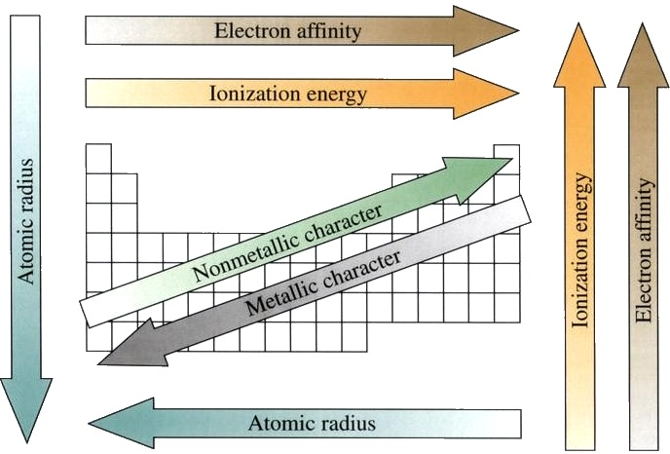

Slide 17
Examples
Which would have a higher electronegativity Phosphorous or Fluorine?
Which has a higher ionization energy Nitrogen or Lithium?

Slide 18
You Try
Which would have a larger atomic radius Phosphorous or Fluorine?
Which has a lower ionization energy sodium or sulfur?

