Slide 1
Warm Up
What is a Physical Change?
What is a Chemical Change?
What are the four signs of a chemical reaction?
Write the formula from the following names:
Magnesium chloride
Manganese (II) fluoride
Sodium sulfate
Lithium hydroxide

Slide 2
Chemical Reactions
Reactions, Day 1

Slide 3
What is a Chemical Reaction?
The process of how a chemical change occurs can be described by a chemical equation.

Slide 4
Chemical Equations
Equations describe a chemical reaction.
General Form:
Reactants → Products
Reactants: what you start with.
Products: what you end with.

Slide 5
Symbols You need to know
Symbol | Meaning
+ | Plus or reacts with
→ | Yields or produces
(s) | Solid
(l) | Liquid
(g) | Gas
(aq) | Aqueous or in solution

Slide 6
Example
H_{2(g)} + O_{2(g)} → H₂O_{(l)}
What are the Reactants?
What are the Products?

Slide 7
Conservation of Matter
1st law of conservation of matter states that matter cannot be created or destroyed, only changed.
H₂ + O₂ → H₂O

Slide 8
Balancing Chemical Equations
IMPORTANT there must be equal amounts of each element on both sides of the equation.
Notes:
marqwis

Slide 9
Balancing Chemical Equations
Coefficients are the large numbers in front of a compound showing how many of that compounds are needed for the reaction to occur.
No coefficient mean that there is only one.
Add only coefficients to change numbers. Never change the subscripts after a formula is written!!!

Slide 10
Steps for Balancing Equations
Balance elements other than O and H first.
Go back and recount
Balance O and H
Go back, recount, and adjust
Go back, recount, and adjust
Go back, recount, and adjust
Go back, recount, and adjust

Slide 11
Examples
N₂+ H₂ è NH₃
Zn + HCl è ZnCl₂ + H₂

Slide 12
Examples
N₂+ 3H₂ è 2NH₃
Zn + HCl è ZnCl₂ + H₂

Slide 13
Examples
N₂+ 3H₂ è 2NH₃
Zn + 2HCl è ZnCl₂ + H₂

Slide 14
Examples
Na₂CO₃ + HCl è NaCl + H₂O + CO₂

Slide 15
Examples
Na₂CO₃ + 2HCl è 2NaCl + H₂O + CO₂

Slide 16
Examples
Na _{(s)} + H₂O_{(l)} è NaOH _{(aq)} + H_{2 (g)}

Slide 17
Examples
2Na _{(s)} + 2H₂O_{(l)} è 2NaOH _{(aq)} + H_{2 (g)}

Slide 18
Examples
S_{8 (s)} + O_{2 (g)} è SO_{3 (g)}

Slide 19
Examples
S_{8 (s)} + 12O_{2 (g)} è 8 SO_{3 (g)}

Slide 20
Word Problems
Make sure you swap and drop your ionic compounds
You have to go from the name to the formula!

Slide 21
Diatomic Molecules
Never exist as just one atom but must be bonded to another
If there’s no other atom around, they will just bond to another of the same atom

Slide 22
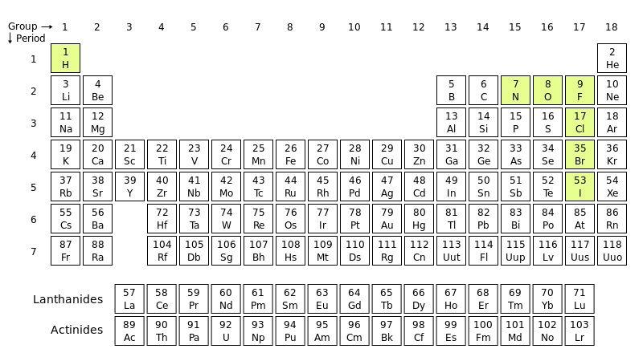

Slide 23
Balance the following
1. ____ Cu(s) + ____ O₂ (g) → ____ CuO(s)
2. ____ H₂O(l) → ____ H₂ (g) + ____ O₂ (g)
3. __ Fe(s) + __ H₂O(g) → __ H₂ (g) + __ Fe₃O₄ (s)
4. ____ AsCl₃ + ____ H₂S → ____ As₂S₃ + ____ HCl

Slide 24
Balance the following
1. 2 Cu(s) + ____ O₂ (g) → 2 CuO(s)
2. ____ H₂O(l) → ____ H₂ (g) + ____ O₂ (g)
3. __ Fe(s) + __ H₂O(g) → __ H₂ (g) + __ Fe₃O₄ (s)
4. ____ AsCl₃ + ____ H₂S → ____ As₂S₃ + ____ HCl

Slide 25
Balance the following
1. 2 Cu(s) + ____ O₂ (g) → 2 CuO(s)
2. 2 H₂O(l) → 2 H₂ (g) + ____ O₂ (g)
3. __ Fe(s) + __ H₂O(g) → __ H₂ (g) + __ Fe₃O₄ (s)
4. ____ AsCl₃ + ____ H₂S → ____ As₂S₃ + ____ HCl

Slide 26
Balance the following
1. 2 Cu(s) + ____ O₂ (g) → 2 CuO(s)
2. 2 H₂O(l) → 2 H₂ (g) + ____ O₂ (g)
3. 3 Fe(s) + 4 H₂O(g) → 4 H₂ (g) + __ Fe₃O₄ (s)
4. ____ AsCl₃ + ____ H₂S → ____ As₂S₃ + ____ HCl

Slide 27
Balance the following
1. 2 Cu(s) + ____ O₂ (g) → 2 CuO(s)
2. 2 H₂O(l) → 2 H₂ (g) + ____ O₂ (g)
3. 3 Fe(s) + 4 H₂O(g) → 4 H₂ (g) + __ Fe₃O₄ (s)
4. 2 AsCl₃ + 3 H₂S → ____ As₂S₃ + 6 HCl

