Slide 1
WATER UNIT
Groundwater
?
?
?
Surface Water
?
?
?
Water Pollution
?
What are some things that might be in each category?

Slide 2
Get out clean sheet of paper, fold in half, & label as follows:
Front side:
Back side:
Water cycle:
Infiltration: Porosity:
Zone of aeration: Zone of saturation: Water Table:
Aquifer:

Slide 3
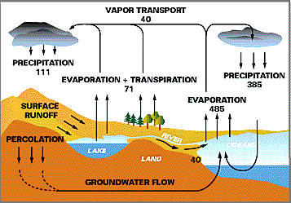
the Water Cycle
this is where it all begins
water vapor
from plants
Heat from the
sun causes this
also called
infiltration

Slide 4
Infiltration (also called percolation) only happens when the ground is permeable
Permeable | Impermeable
water can pass through | water cannot pass through
sedimentary rock sand & silt loam compost / humus | igneous & metamorphic rock *bedrock layer clay asphalt / concrete

Slide 5
Porosity & Permeability
Porosity = amount of water that can be stored in the pore spaces
Permeability = ability of water to flow through connected pore spaces
pore spaces
are air !!!

Slide 6
Groundwater water stored underground
Zone of aeration
Unsaturated zone
Pore spaces in the material are filled mainly with air
Zone of saturation (also called an Aquifer)
Pore spaces in the material are filled with water
Water within the pores is groundwater
Water table --the upper limit of the zone of saturation
water table can move up when it rains or down during a drought

Slide 7
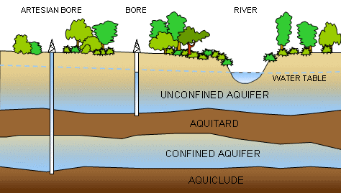
Aquitard – an impermeable layer of material
WELL
WELL
Zone of Aeration
Zone of Saturation
Bedrock

Slide 8
Two Types of Aquifers
type of aquifer | unconfined | confined
description | water rests on an impermeable layer; ground above it is permeable; can be refilled from rainwater that infiltrates | water trapped between 2 impermeable layers; water becomes pressurized; cannot be refilled from rainwater infiltration
type of well | regular well (water needs to be drawn or pumped out) | Artesian well (water rises under its own pressure)

Slide 9
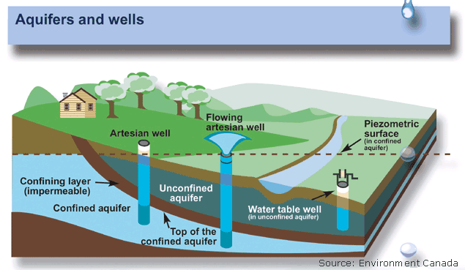
Well - hole drilled into the zone of saturation
Artesian Well – well drilled into a confined aquifer; rises under its own pressure

Slide 10
Foldable: Springs and Cones of Depression
Diagram of a Spring:
Diagram of a Cone of Depression:
Subsidence:
How do both of these affect people living in a close proximity to them:

Slide 11
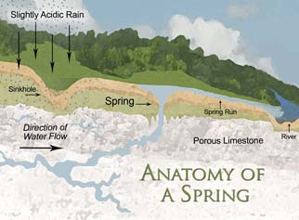
Springs
Spring
groundwater that emerges naturally from the surface
when the water table intersects with the surface of Earth

Slide 12
Groundwater Overuse
Subsidence = sinking of the ground level caused by lowering of the water table
occurs if water is used faster than it is replenished
Creates depressions or sinkholes

Slide 14
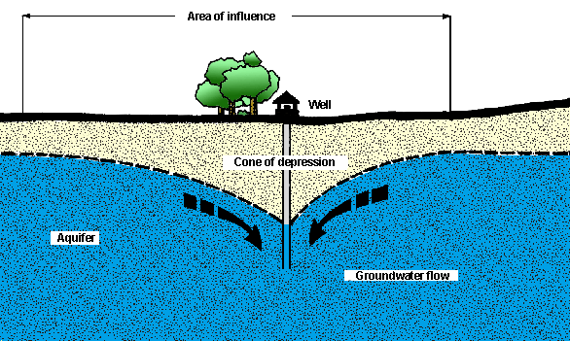
Cone of depression – lowering of the water table around a well due to large amounts of water being pumped out

Slide 15
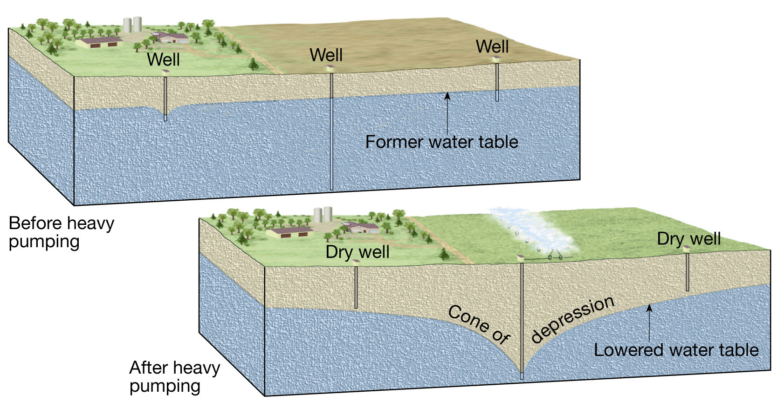

Slide 16
Foldable Pollution
Vocab: Point of Pollution
Contamination: Source Non-Source
Septic Tank:
Landfill:
Leachate: Stormwater Wastewater
Turbidity
Spreading:
Estuary:

Slide 17
Water Pollution
Contamination = state of something that is considered impure, unclean, or unhealthy
Septic Tank = underground storage of sewage
Landfill = underground storage for garbage
Leachate = groundwater that leaks out of a septic tank or landfill, “Garbage Juice”

Slide 18
Types of water pollution
Point Source Pollution | Nonpoint Source Pollution
contaminants have an identifiable source | contaminant source cannot be found
Smokestack from a single factory Car that is leaking lots of gas or oil Repair garage that dumps old oil Household that dumps chemicals Factory with a leaking chemical tank | Acid Rain Runoff from farmlands (contains fertilizers & animal manure) Runoff from parking lots (contains oil & gasoline) Runoff from city streets (contains highways salts & oil) Runoff from construction sites (contains sediment pollution)

Slide 19
Sources of Groundwater Contamination
Sewage from septic tanks, farm wastes, or broken sewer lines
Fertilizers & pesticides from agriculture
Residential runoff
Highway salts
Chemical & industrial materials that leak from pipelines, storage tanks, landfills, or holding tanks
Saltwater in coastal areas
Minerals & nutrients from dissolved rock

Slide 20
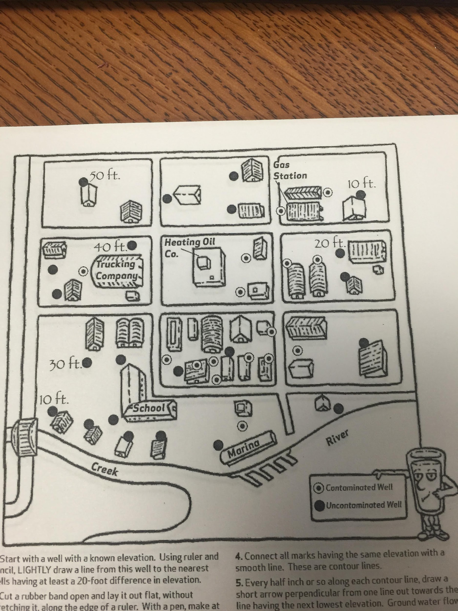

Slide 21
extra terminology:
healthy stream = has lots of living things, especially macro(large) invertebrates (animals without backbones)
buffer zone = plants/vegetation around the banks of rivers to absorb & slow runoff water
river delta = triangle shaped, where a river slows before it enters a large body of water, high deposition
estuary = ecosystem where fresh water mixes with salt water
turbidity = measure of how clear water is; high turbidity is a sign of an unhealthy stream

Slide 22
Surface Water
stormwater = runoff from impermeable urban areas such as rooftops, roads, & parking lots
wastewater = sewage or any other water used and considered unhealthy

Slide 23
Contaminant Spreading
Flow downhill – contaminants leaked into the ground at the top of a hill will flow downhill
Rainwater runoff – runs through the contaminant, absorbs it, and transfers it to another area

Slide 24
Groundwater Cleaning
Infiltration/Percolation - if water travels slowly through permeable sediment, the water is purified

Slide 25
answer with a partner:
What is a cone of depression?
What is another word for the “zone of saturation”?
What is transpiration?
List 3 materials that are permeable.
What is an artesian well?
Give 2 examples of nonpoint pollution.
What is an unconfined aquifer?
What is porosity?

Slide 26
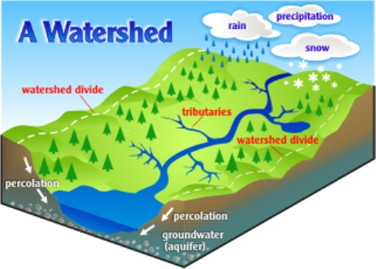
River basin (watershed) = entire land area that drains into streams that flow into one large river.
Divide = imaginary line at high elevation points that separates river basins from each other.
Tributaries = small streams that flow into larger streams & rivers.

Slide 27
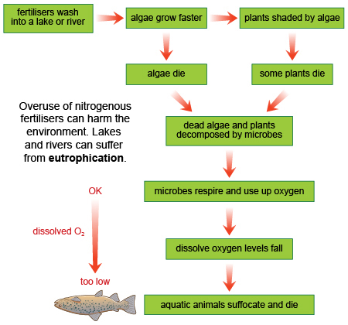
Eutrophication
excessive nutrients in a body of water, frequently due to runoff from the land, which causes a dense growth of plant life & death of animal life from lack of oxygen

Slide 28
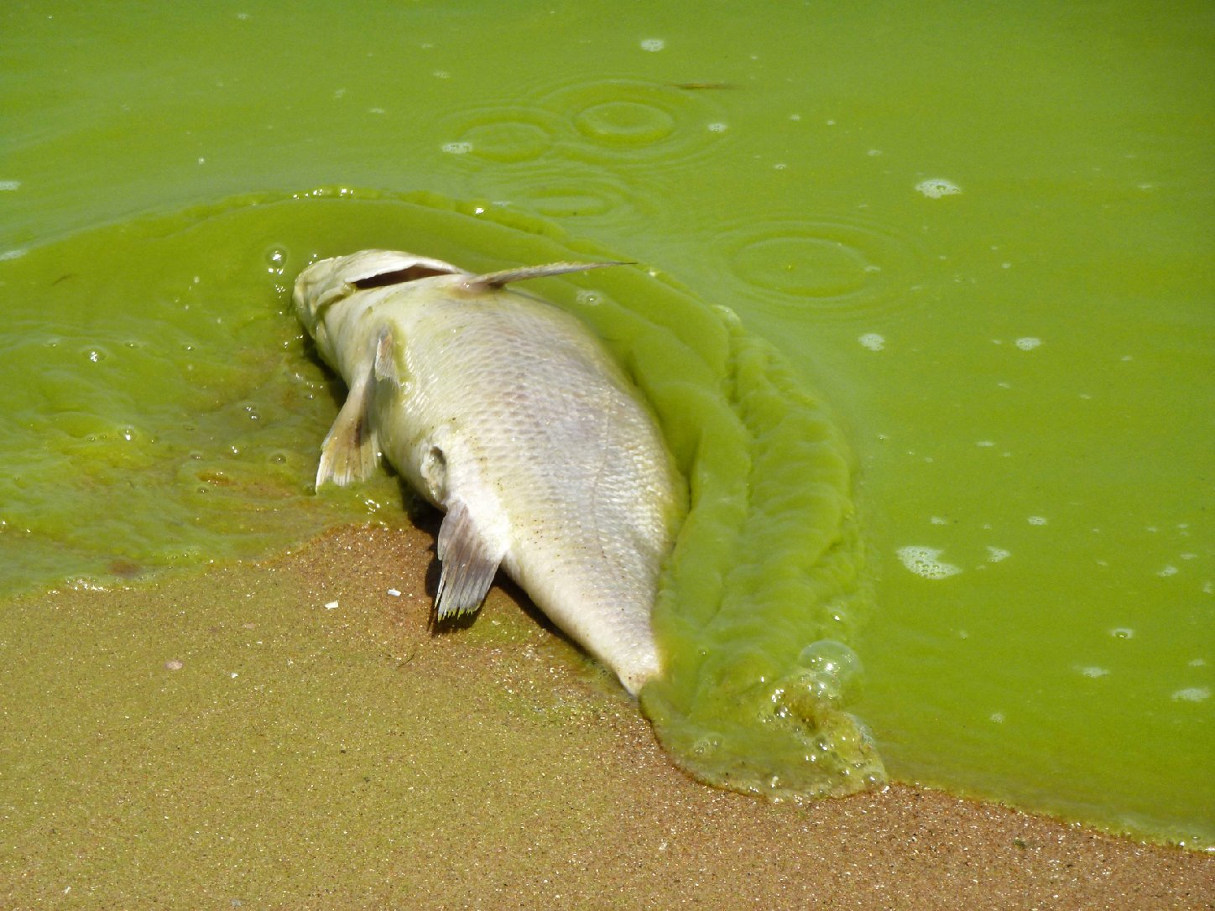
Eutrophication

Slide 29
Questions for Pollution Map
1. If the flow of ground water and the pollutants in it follow the contour of the land, what is the mostly likely source of the contamination, the Heating Oil Co., the Trucking Co. or the Gas Station?
2. The contamination plume will continue to spread slowly through the ground, much like smoke from a chimney drift- ing into the wind. Describe where on your map you think the plume will move with time.
3. Which of the uncontaminated wells do you expect to become contaminated in the near future? Do you think the school's water well will be contaminated?
4. How do you explain the fact that one well within the plume was not contaminated?
5. Is it possible you are wrong in assuming that ground water flow follows the contour of the land? What else could you investigate to be sure?
6. Assuming that ground water flow does follow the con- tours of the land, is it possible that there are two sources of contamination? What would you expect to find if all three companies had leaking storage tanks and were actu- al sources of contamination?

Slide 30
North Carolina’s River Basins
There are 17 river basins in N.C.
Some empty into the Mississippi River & the Gulf of Mexico while all the others empty into the east coast Atlantic Ocean.
The Catawba supplies the drinking water to the city of Charlotte.
The Catawba is one of the most endangered rivers in the U.S. due to pollution.

Slide 31
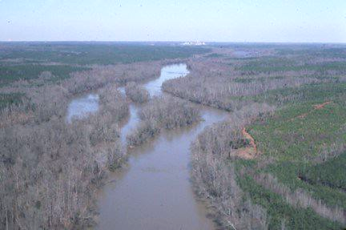
NC River Poster Assignment
Posters must include:
At least 5 colors, neatness
Size of basin
Miles of streams/rivers
Location in NC
Draw a plant or animal
Describe a water quality issue
Explain or propose a solution to a water quality issue
A unique geological or water feature
Draw you & your partner doing one of the recreational activities

Slide 32
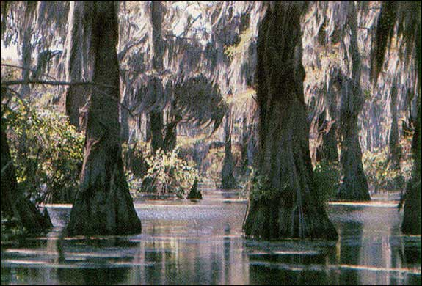
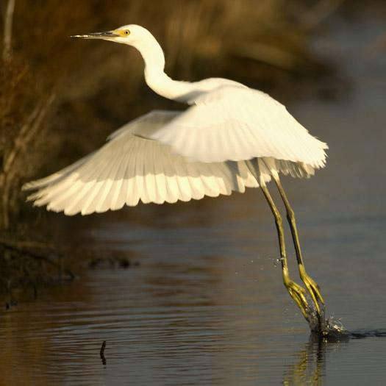
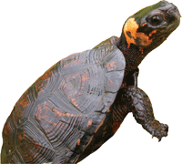
Wetlands Land covered by water all or part of the year.
3 functions:
Provide flood protection during storms
Filter pollution & urban runoff
Habitat for many animals
Includes swamps, marshes, & bogs

Slide 33
Wetland Habitat Flow Chart
Salt Marsh
Tidal Freshwater
Sandy Beach
Mud Flat
Rocky Shore
Forested Wetland
Shrub Swamp
Wet Meadow
Bog
Seagrass Bed
Aquatic Plant Bed
Steam Bed
Open Water

Slide 34
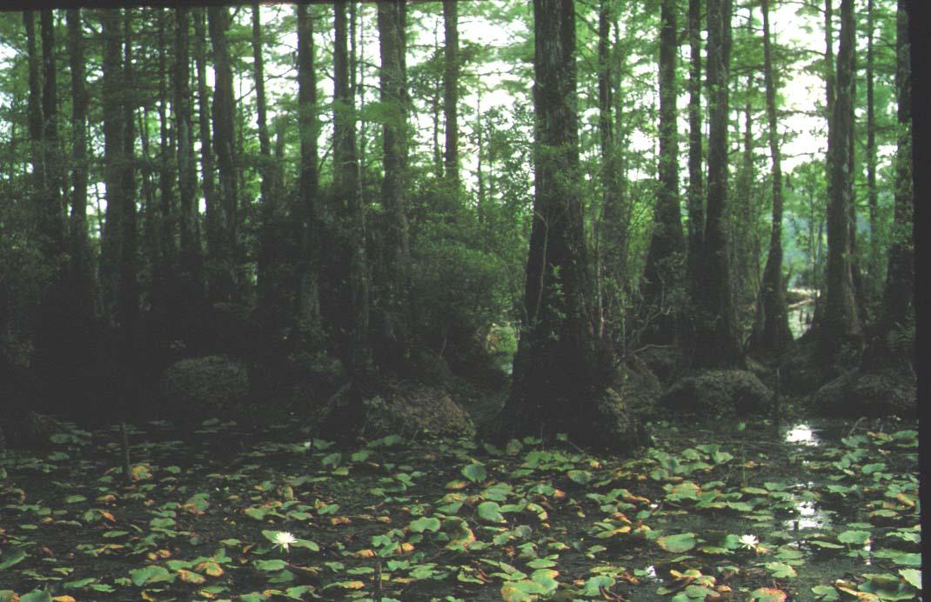
Swamp Forest
“In nature there are no rewards or punishments, only consequences”
Should we drain wetlands like this to make room for homes, restaurants, & malls?

Slide 35
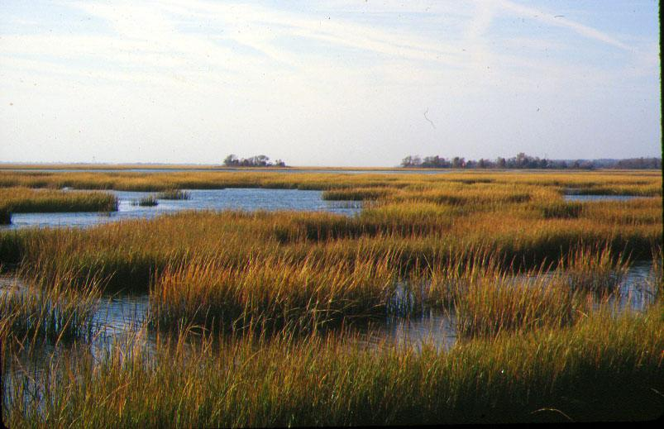
Tidal Salt Marsh
Laws now prevent the destruction of wetlands
Developers must create new wetlands if they destroy old ones

