Slide 1
Oceans & Atmosphere
Chap. 14 & 17
Ocean Currents / Waves / Tides
Layers of atmosphere / ozone
Coriolis Effect
Heating Land & Water

Slide 2
Waves
A Wave is a rhythmic movement that carries energy through matter or space.
In oceans, waves move through seawater

Slide 3
Waves
Caused by:
Wind
Earthquakes
Gravitational force of the Moon and Sun.

Slide 4
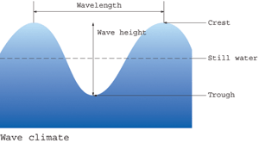
Wavelength
Crest
Wave Height
Still Water
Trough
Wave Parts

Slide 5
Wave Movement
When a wave passes through the ocean, individual water molecules move up and down but they do not move forward or backward.

Slide 6
Gravitational Effect of the Moon
Two big bulges of water form on the Earth:
one directly under the moon
another on the exact opposite side
As the Earth spins, the bulges follow the moon.

Slide 7
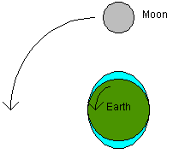

Slide 8
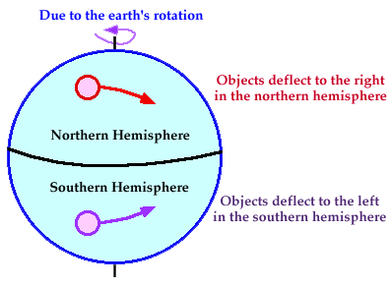
Coriolis Effect

Slide 9
Ocean Currents
basic terminology
Gyre = Giant whirl of circular movement in an ocean basin.
Deep currents= Form due to changes in density. Changes in density are due to differences in Temp and salinity.
Surface currents= caused by the friction of the wind blowing over the ocean surface.
Upwelling= Rising of cold water from deeper layers to replace warmer surface water

Slide 10
Global Conveyor Belt
Also called: | Thermohaline Circulation
Definition: | Worldwide…
Factors:
Picture:

Slide 11
El Nino / La Nina Cycle
Normal Condition | El Nino (boy) | La Nina (girl)
LOW press. over Asia HIGH press. over S. America winds blow east to west | HIGH press. over Asia LOW press. over S. America winds blow west to east | LOW press. over Asia HIGH press. over S. America winds blow east to west
normal amount of upwelling | warm phase no upwelling | cool phase extra upwelling

Slide 12
Atmosphere Layers
Thermosphere | outermost layer / close to space temperature increases where the Aurora Borealis happens
Mesosphere | no well-defined upper limit temperature decreases
Stratosphere | contains Ozone Layer Ozone Gas molecule = O₃ (3 atoms of oxygen) protects us from U.V. (ultraviolet) radiation
Troposphere | most gases, heaviest, most dense 78% Nitrogen, 21% Oxygen, 0.03% Carbon Dioxide we live in this layer, all mountains are here
Sea Level | The level of the ocean / beach 0 meters in elevation

Slide 13
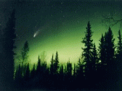
Aurora Borealis
Also called “The Northern Lights”
Strange, glowing lights seen in the northern latitudes.
Caused by charged particles (ions) entering the thermosphere.
These particles become “excited” causing them to produce the light we see.
Aurora Borealis

Slide 14
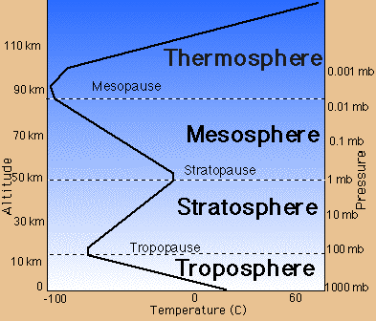

Slide 15
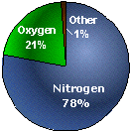
Atmosphere Gases
78% = Nitrogen
21% = Oxygen
<1% = Argon, Carbon
Dioxide, & others
% | 78% | 21% | <1%
gas | Nitrogen | Oxygen | Ozone | Carbon Dioxide | Argon | Hydrogen
atom(s) | N | O | O | C & O | Ar | H
molecule | N2 | O2 | O3 | CO2 | -- | H2

Slide 16
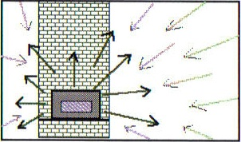
Energy Transfer
Conduction | Convection | Radiation
Transfer of heat from one object to another through touch | Transfer of heat from one place to another through circulation | Transfer of energy in the form of waves
A spatula warms up after sitting in a hot pan. | In the ocean, warm currents move heat from the equator to higher latitudes. | Radiant heat energy that is emitted by an oven.
Notes:
‹#›

Slide 17
Solar Radiation
reflect = light bounces off in 1 direction
absorb = object takes in heat & energy
Notes:
‹#›

Slide 18
Heating Land & Water Lab
Heat equator = AKA “thermal equator” a set of locations encircling the Earth having the highest mean (average) annual temperature.
Specific heat = energy required to raise the temperature of 1 unit of mass by 1degree
Radiative balance = balance of heat energy flowing into Earth’s atmosphere & leaving into space
Isotherm = line on a map that shows areas of equal temperature

Slide 19
Temperature Differences of Land & Water
Land heats & cools more quickly than water.
Temperature fluxuations for land are greater than water.
Land heats up to a higher temp. than water & will cool lower than water.
N. Hemisphere = 39% land
S. Hemisphere = 19% land.
What does this indicate?
Notes:
‹#›

Slide 20
Temperature Differences with Geography
In California, wind blows mainly from water to land & temperatures stay relatively consistent.
In New York, wind blows mainly from land & temperatures change frequently.
Notes:
‹#›

