Slide 1
Introduction to Earth and Environmental Science
Unit 1

Slide 2
Earth vs. Environmental Science
Earth Science
How Earth naturally functions
Environmental Science
Human impact on the way Earth naturally functions
Spheres: Subjects:
Geosphere → Geology
Atmosphere → Meteorology
Hydrosphere → Oceanography
Biosphere → Ecology
Space:
Earth’s place
in the universe→ Astronomy

Slide 3
Earth vs. Environmental Science
Branch | Definition
Earth Science | Any area of science that deals with the composition, structure, and occurrences of Earth.
Geology | The study of nature, formation, origin, and development of Earth’s crust and its layers.
Oceanography | The study of the biology, chemical composition, and structure of the oceans.
Meteorology | The study of Earth’s atmosphere (weather).
Astronomy | The study of outer space.

Slide 4
The Hydrosphere
Includes all the water found on Earth.
Water continually moves
97% of Earth’s water - Salt water
3% - groundwater glaciers, streams, rivers, lakes, etc.

Slide 5
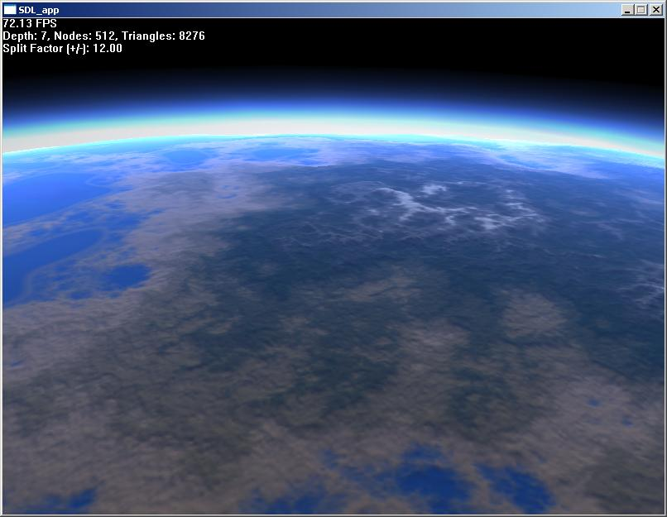
The Atmosphere
Includes all the gases that surround Earth.
Provide animals and plants with gases needed for life
Protects us from the sun’s heat and radiation

Slide 6
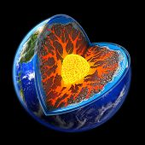
The Geosphere
Contains the core, the mantle, and the crust of Earth.
Crust
the outer edge of Earth and it does not have the same composition and thickness throughout Earth.
Mantle
contains some molten (melted) material and can flow while other areas of Earth cannot.
Core
contains the heavy, dense materials of Earth.

Slide 7
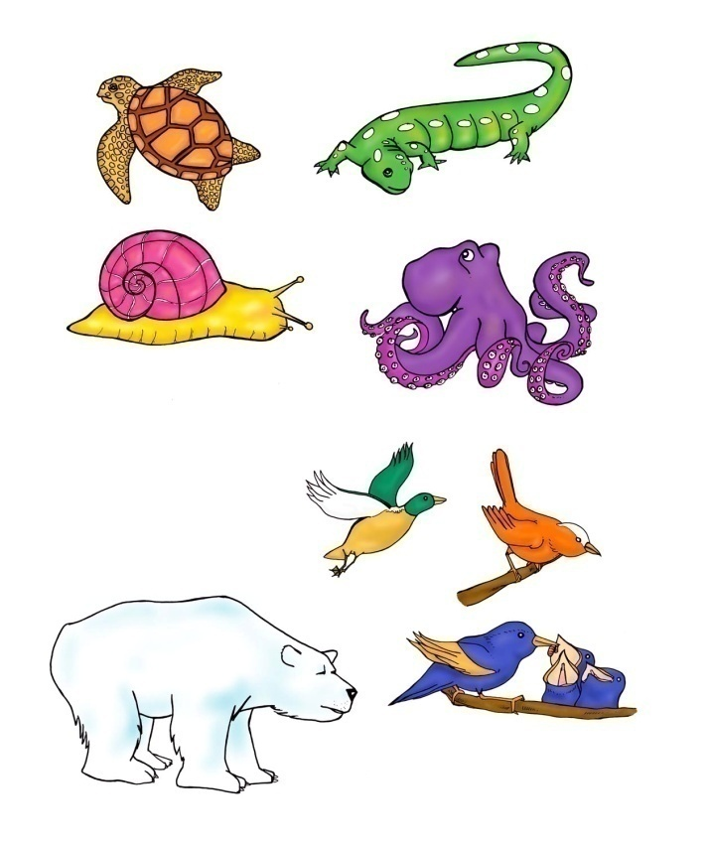
The Biosphere
Contains all living things on Earth.
Extends from the ocean floor to the atmosphere.
Reactions with the environment help animals and plants maintain and alter their physical environment.
All of Earth’s sphere interact with each other constantly.

Slide 8
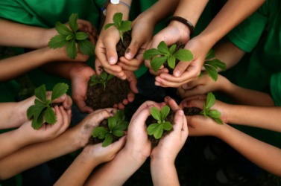
Earth vs. Environmental Science
Environmental Science
Dealing with human interactions with the environment
Negative: pollution, deforestation, habitat destruction, etc.
Positive: reforestation, endangered species lists, etc.

Slide 9
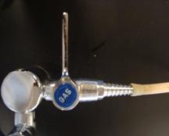
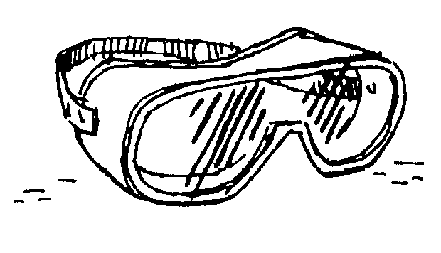
Lab Safety
Gas nozzles
Perpendicular when turned off
Fume hood
Used for taking fumes and smoke out of the room
Clean up all water from the floor
# 1 lab injury! – slipping on water on the floor
Safety Shower and Eye Wash Station
Only to be used in an EMERGENCY
Water flows onto the floor

Slide 10
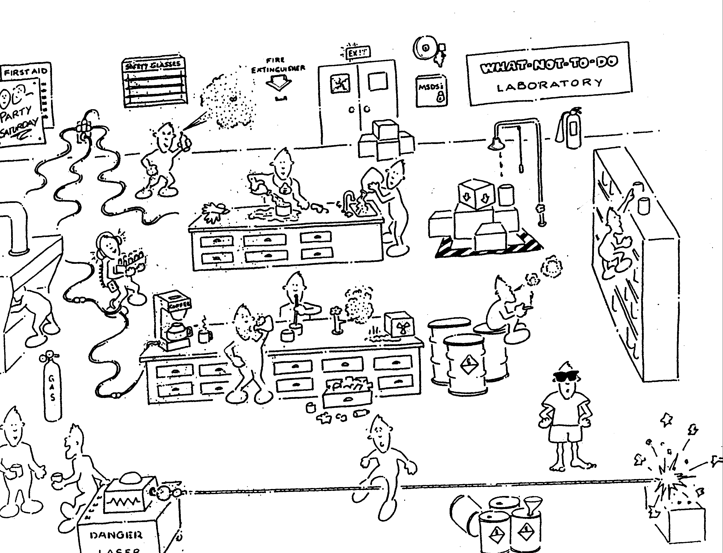
What-Not-To-Do Laboratory

Slide 11
Steps of The Scientific Method
The set of procedures by which scientists learn about the world.
Purpose/Question (Why we are doing the experiment)
Background Information (What do we already know that will help us)
Hypothesis (What do you predict will happen – be specific)
Experiment (do the lab)
Data/Analysis (what did results of the experiment mean)
Conclusion (Present Finding and restate hypothesis)

Slide 12
The Scientific Method
Observations
Learning about the natural world and the principles that explain these facts through the 5 senses.
Reasoning
Induction: Using several separate observations to arrive at general principles.
Deduction: Reasoning from general principles to specific conclusions.

Slide 13
The Scientific Method (cont’d)
Hypothesis
A statement about the world that might be true and is testable (can be proven right or wrong).
Independent Variable
The factor that is being tested and is changed.
Dependent Variable
The factor that is responding to the changes of the independent variable.
Constant
The factor that remains constant so that it does not affect the experiment.

Slide 14
The Scientific Method (cont’d)
Experimental group
The group in the experiment that is manipulated or changed
The independent variable is used on this group
Control group
The group that is not changed or manipulated
Used to compare to the experimental group

Slide 15
The Scientific Method (cont’d)
Scientific Theory
Well-tested hypothesis
Regarded as true
Can be proven false if there is enough evidence to disprove it
Examples:
Big Bang Theory
Theory of Evolution
Theory of Plate Tectonics
Scientific Law
Well-tested hypothesis
Regarded as true
Can be shown using MATH
Examples:
Law of Gravity
Laws of motion
Kepler’s Laws

Slide 16
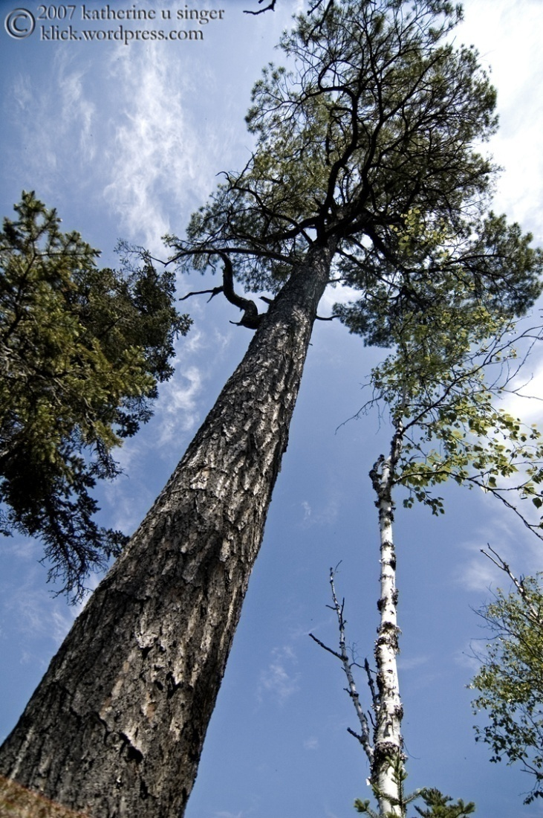
Data Types
Qualitative
Written in words
Describes the quality or nature of something
Examples:
“The room is clean”
“The chair is blue”
Quantitative
Written with numbers
An amount or quantity of something
Examples:
“There are 8 lab benches”
“ I am 6ft tall”

Slide 17
How are you feeling today?
Qualitatively, I feel…
Word
Quantitatively, I feel…
Number
On a scale of ☹ 1→10 ☺

Slide 18
Measurement
Comparing an object or a process to a standard
American measurement: English System
Inches, yards, Fahrenheit, pounds, etc.
Scientific/international measurement:
International System of Units (SI)
Meters, Celsius, grams, etc.

Slide 19
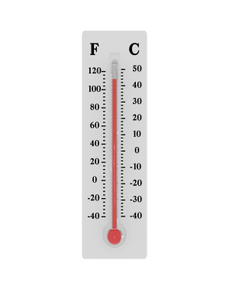
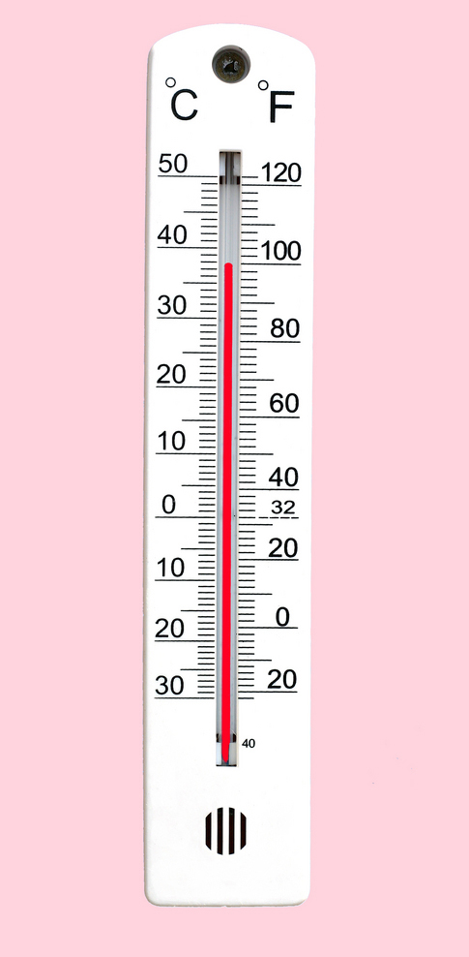
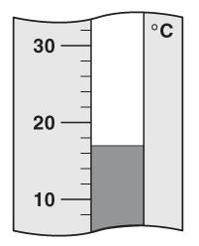

Slide 20
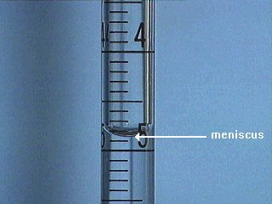
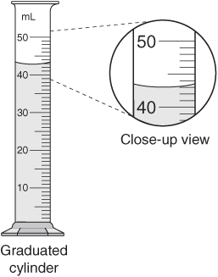
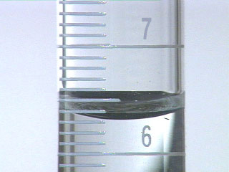

Slide 21
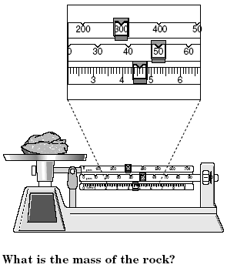
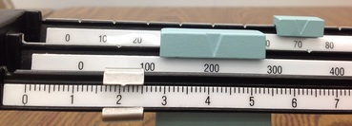

Slide 22
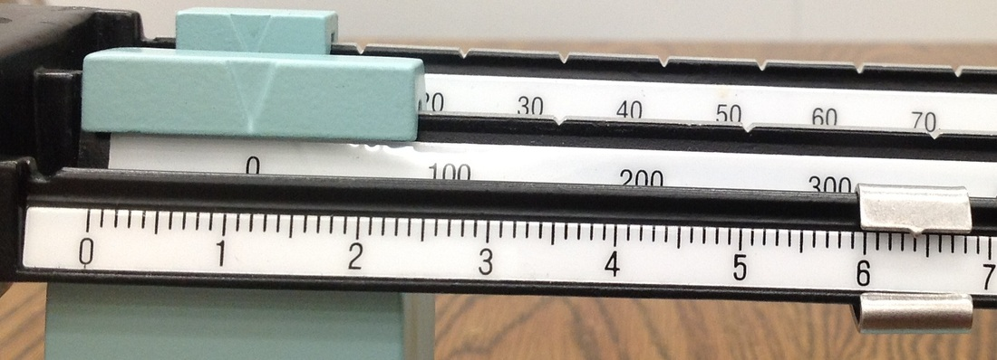
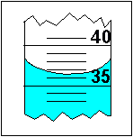
1.
2.
3.
________ °C

Slide 23
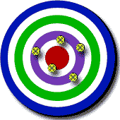
Accuracy vs. Precision
Accuracy
How close a measured value is to a true value
Precision
How close measured values are to each other
The more decimal points, the more precise a tool is
2.34 grams vs. 2.3 grams
Low Accuracy High Precision | High Accuracy Low Precision | High Accuracy High Precision

Slide 24
Important Pre-fixes
Prefix | Meaning | Abbreviation | Exponential Notation
Peta- | quadrillion | P | 10¹⁵
Tera- | trillion | T | 10¹²
Giga- | billion | G | 10⁹
Mega- | million | M | 10⁶
kilo- | thousand | k | 10³
hecto- | hundred | h | 10²
deka- | ten | da | 10¹
deci- | tenths of | d | 10⁻¹
centi- | hundredths of | c | 10⁻²
milli- | thousandths of | m | 10⁻³
micro- | millionths of | µ | 10⁻⁶
nano- | billionths of | n | 10⁻⁹
pico- | trillionths of | p | 10⁻¹²
Examples:
1 kilogram=1000 grams
1 milligram=1/1000 grams
1 gigabyte= 1,000,000,000 bytes
1 nanosecond= 1/1,000,000,000 sec
1 micrometer= 1/1,000,000 meter
How many grams are in a kilogram?
How many millimeters are in a meter?

Slide 25
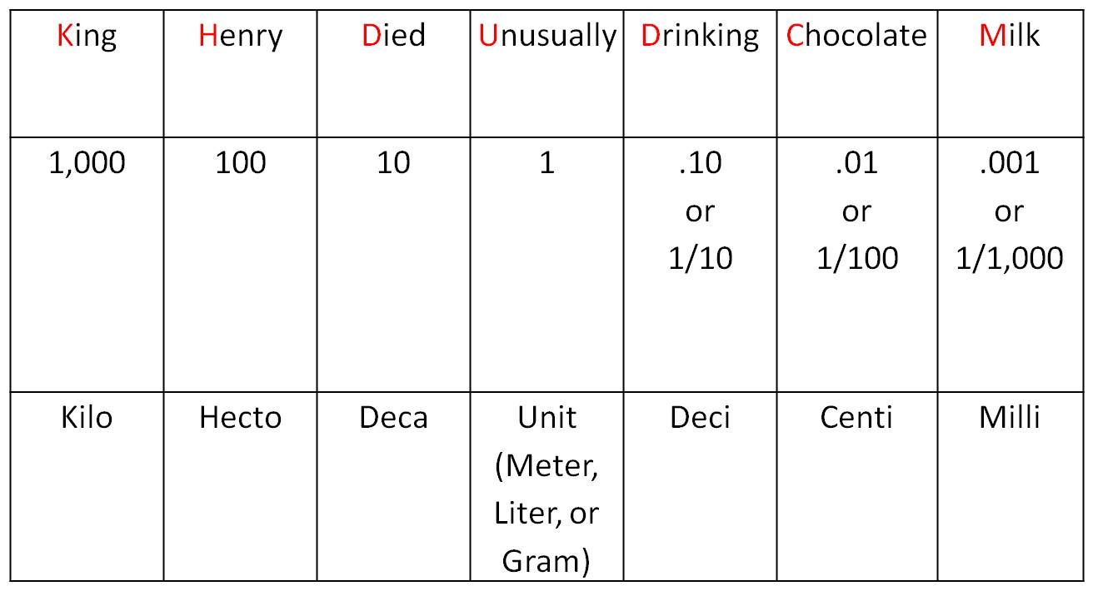
Metric System Conversions

Slide 26
Unit Conversion
When you divide a unit by itself, we say it CANCELS out because the result is equal to 1.
1/1=?
2/2=?
3/3=?
a/a=?
Meter/meter=?
Kilogram/kilogram=?

Slide 27
Steps of Unit Conversion
Write down the number and units you are starting with.
Identify the equality that relates the units you have to the units you want.
Put the equality in the form of a fraction (equal to 1!)
units that you need to cancel on bottom
units you desire to keep on top
Perform multiplication, and cancel the units!

Slide 28
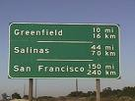
Unit Conversions: Distance
Metric Examples
6.2 m to mm
945 mm to m
5479 km to mm
English/Metric Examples
3 in to cm
8 cm to in
9 ft to m
1 inch = 2.54 cm
1 foot = 12 inches
1 mile = 5280 feet

Slide 29
Unit conversions: Time
Examples:
45 min to hr
90 sec to min
3 days to hr
3 days to min
1 year to sec

Slide 30
Unit conversions: Mass
42 g to kg
.89 kg to g
3.9 kg to mg
1890 mg to kg
.0534 kg to µg

Slide 31
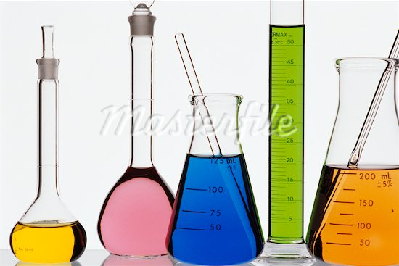
Unit conversions: Volume
1 cm³ = 1 mL
Examples:
34 mL to L
548 mL to L
.235 L to mL
.78 L to mL
4 cm³ to mL
4 cm³ to L

Slide 32
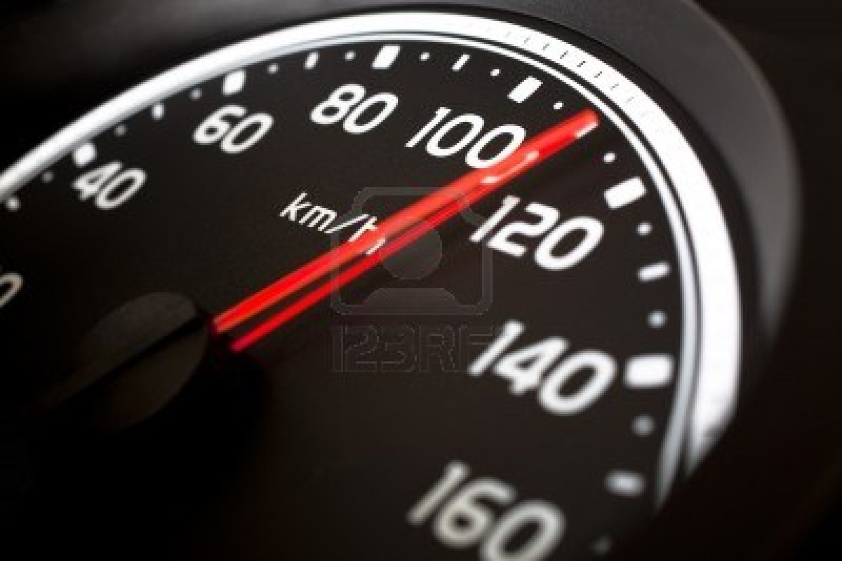
Unit conversions: Velocity
350 m/s to km/s
.98 km/s to m/s
20 km/h to mi/hr
70 mi/hr to km/hr

