Slide 1
Cosmic Size
Universe
Galaxies
Asteroids, meteors, meteorites, comets
Star clusters
Solar systems
Planets, moons
Stars

Slide 2
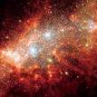
Galaxies and Stars
Spiral
Elliptical
Galaxies – billions of star groups
more than 100 billion galaxies, each containing billions of stars.
Irregular

Slide 3
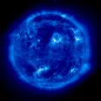
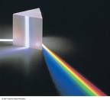
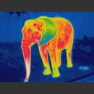
Light: Electromagnetic spectrum & Doppler Shift

Slide 4
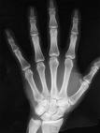
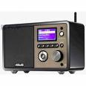
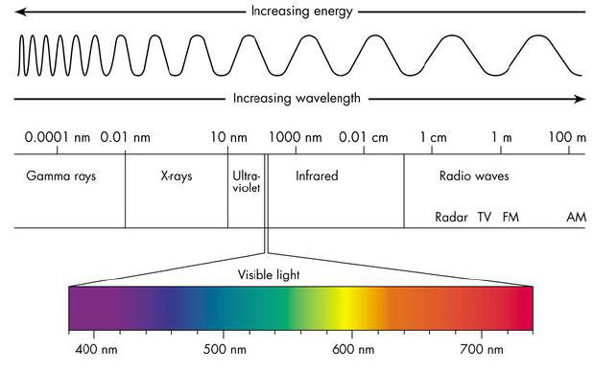
The Electromagnetic Spectrum

Slide 5
Cosmic Speed Limit
Speed of light = 300,000 km/s
Light-year = the distance light travels in one year = 9,500,000,000,000 km
The 2nd nearest star is 4.3 light years away

Slide 6
Spectrum: light separated into component wavelengths
Droplets of water, diffraction grating, and spectroscopes all act like a PRISM to separate different wavelengths (colors) of light

Slide 7
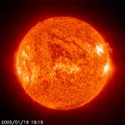
Incandescence: glowing from heat
Blue = hottest Red=coolest

Slide 8
Types of spectra
Sunlight, light bulbs
Sunlight that has traveled through our atmosphere
Hot gas

Slide 9
Doppler Effect
Pitch: higher
Light: bluer
Pitch: Lower
Light: redder

Slide 10
Doppler shifts from stars

Slide 11
Big Bang Theory
At one time, the universe was a dense, hot, supermassive ball.
About 13.7 billion years ago, a violent explosion occurred sending material in all directions into space.

Slide 12
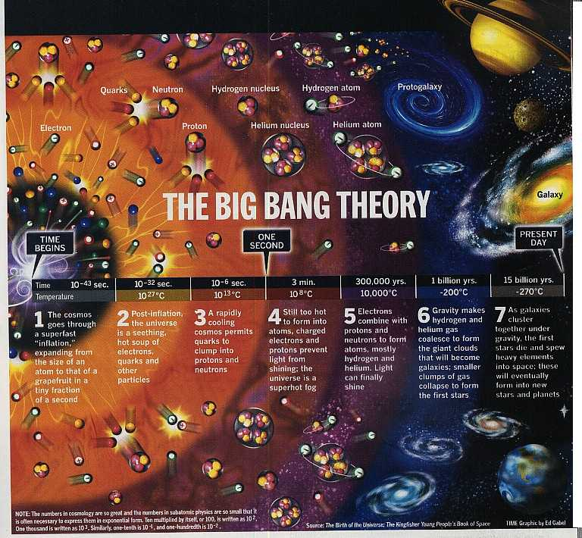
This marked the beginning of the universe.
Eventually, matter cooled and condensed into galaxies, stars, and planets.

Slide 13
Support for the Big Bang Theory
Red shifts
Cosmic background radiation
Radio signals coming from every direction in space.
Believed to be created by the big bang explosion.

Slide 14
Cosmic Background Radiation (CBR)
The hypothesis that the universe has always been expanding (since the “Big Bang”) predicted (1948) that radiation produced from the first moment of expansion would permeate the universe.
In 1965 this radiation was discovered
In 2003 astronomers studying the CBR determined the universe is 13.7 billion years old

Slide 15
Nebula
A cloud of dust and gas created the planets in our solar system.

Slide 16
Nebular Hypothesis
Nebula (mostly hydrogen and helium)
Started rotating and collapsing toward center (accretion disc)
Rocky and metallic materials form as nebula cools

Slide 17
Nebular Hypothesis (cont’d)
Collisions of particles created asteroid-sized objects
Asteroids combined to form rocky/terrestrial planets (Mercury, Venus, Earth, Mars)
Gases and lighter particles formed gas/Jovian planets (Jupiter, Saturn, Uranus, Neptune)

Slide 18
Kepler’s Laws
1st Law: orbital paths are ellipses (ovals)
2nd Law: a planet sweeps out equal areas in equal times
3rd Law: the length of time it takes a planet to orbit the sun and its distance to the sun are proportional
The closer to the sun, the shorter the orbital period

Slide 19
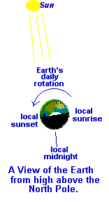
Earth’s Motions
Rotation
spinning of Earth from west to east
results in day and night
Earth makes a complete rotation in 24 hours
Revolution
Earth moves around the sun every 365¼ days

Slide 20
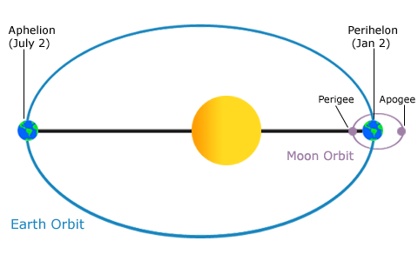
Earth’s Motions (cont’d)
Perihelion – Earth is closest to the sun
Aphelion – Earth is farthest from the sun

Slide 21
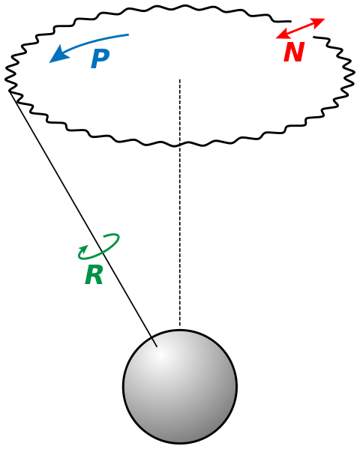
Earth’s Motions (cont’d)
Precession
The change in direction of the northern axis
North star is different
Nutation
Slight change in Earth’s axis from 23.5°
Very slow movement

Slide 22
Earth’s Seasons
Earth’s axis is tilted 23.5º
March 20/21 – Spring Equinox
June 21/22 – Summer Solstice
September 22/23 – Autumn Equinox
December 21/22 – Winter Solstice

Slide 23
Earth-Moon Motions
The moon moves counterclockwise to Earth
Perigee – moon is closest to Earth
Apogee – moon is farthest from Earth
Phases of the moon are the different amounts of light that appears on the moon
(see illustration)

Slide 24
Lunar Eclipses
Occurs during full moon phases
Sun, Earth, moon
Penumbra – light is partially blocked by Earth
Umbra – light is completely blocked by Earth

Slide 25
Solar Eclipses
Occurs when sun is blocked by the moon
Sun, moon, Earth
If the moon is partially blocking the sun, a partial solar eclipse will occur

Slide 26
The Expanding Universe
1929 – Edwin Hubble found that the universe is expanding
Estimated distances, relative brightness, Doppler red shifts

Slide 27
Dimmer galaxies had greater red shifts → farthest from Earth and moving faster
Hubble’s Law: the more distant the galaxy, the greater the red shift- they are moving away at faster speeds.

