Slide 1
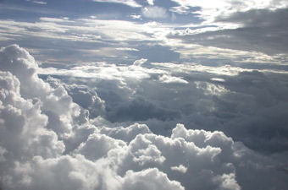
Meteorology
study of atmosphere & weather events
Weather | Climate
Atmosphere conditions in a short period of time | Atmosphere conditions over a long period of time
constantly changing | generalized

Slide 2
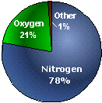
Atmosphere Gases
78% = Nitrogen
21% = Oxygen
<1% = Argon, Carbon
Dioxide, & others
% | 78% | 21% | <1%
gas | Nitrogen | Oxygen | Ozone | Carbon Dioxide | Argon | Hydrogen
atom(s) | N | O | O | C & O | Ar | H
molecule | N2 | O2 | O3 | CO2 | -- | H2

Slide 3
Atmosphere Layers
almost no gas | Thermosphere | outermost layer / close to space temperature increases where the Aurora Borealis happens international space station orbits here
< 1 % | Mesosphere | no well-defined upper limit temperature decreases
19 % | Stratosphere | contains Ozone Layer Ozone Gas molecule = O₃ (3 atoms of oxygen) protects us from U.V. (ultraviolet) radiation
80 % | Troposphere | most gases, heaviest, most dense 78% Nitrogen, 21% Oxygen, 0.03% Carbon Dioxide we live in this layer, all mountains are here
 | Sea Level | The level of the ocean / beach 0 meters in elevation

Slide 4
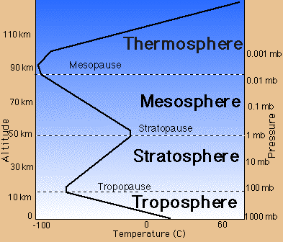

Slide 5
Temperature | Heat
measurement of how rapidly or slowly molecules move around | transfer of energy that occurs because of a difference in temperature between substances
Transfer of Energy:
Conduction | Convection | Radiation
Transfer of heat from one object to another through touch | Transfer of heat from one place to another through circulation | Transfer of energy in the form of waves
A spatula warms up after sitting in a hot pan. | In the ocean, warm currents move heat from the equator to higher latitudes. | Radiant heat energy that is emitted by an oven.

Slide 6
The Coriolis Effect
As Earth spins, anything (planes, boats, water, wind, & molecules) moving in a straight line will be deflected.
N. Hemisphere = right. S. Hemisphere = left.

Slide 7
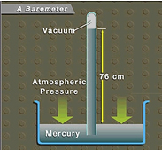
Air Pressure
Force exerted on an object by the air (molecules).
Occurs in all directions → up, down, & sideways
Barometer = instrument used to measure air pressure.
Units = mmHg
(millimeters of Mercury)
or atm (atmospheres)
Sea Level = 1 atmosphere

Slide 8
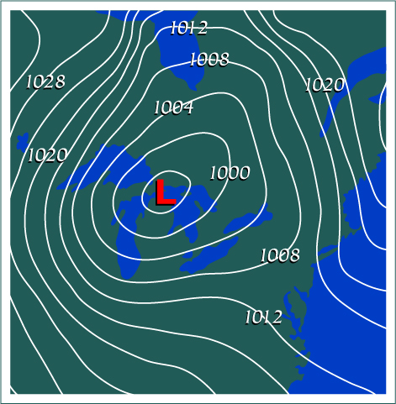
Air Pressure (continued)
Isobars = lines on a weather map that connect areas of equal pressure
“H” = high pressure cell
“L” = low pressure cell
How does air move?
air moves from
High to Low

Slide 9
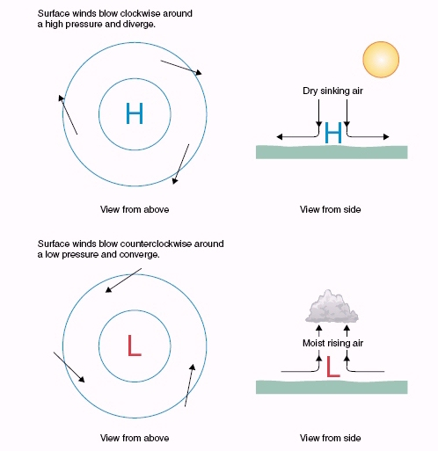
High & Low Pressure Cells
clear skies
outward
sinking air
C.W.
cloudy skies
inward
rising air
C.C.W.

Slide 10
Cyclones & anticyclones
Anticyclone
Center of HIGH pressure (“H” in BLUE)
Pressure increases toward the center
Winds associated with an anticyclone:
Outward (divergence)
C.W. = Clockwise (opposite in the Southern Hemisphere)
Associated with subsiding (sinking) air
Usually bring "fair" (clear) weather

Slide 11
Cyclones & anticyclones
Cyclone
Center of LOW pressure (“L” in RED)
Pressure decreases toward the center
Winds associated with a cyclone:
Inward (convergence)
C.C.W. = Counterclockwise (opposite in the Southern Hemisphere)
Associated with rising air
Bring clouds & precipitation

Slide 12
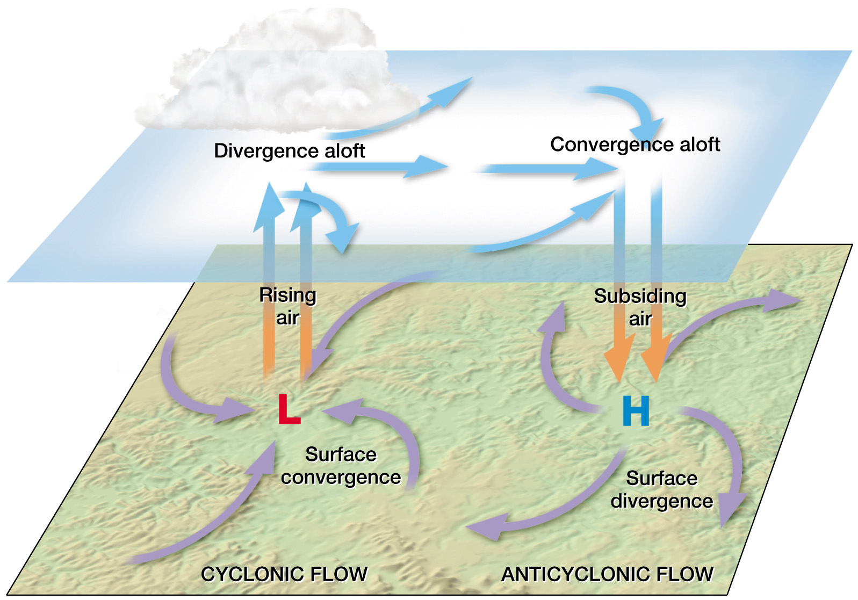
Airflow of cyclones & anticyclones
aloft = high in the atmosphere

Slide 13
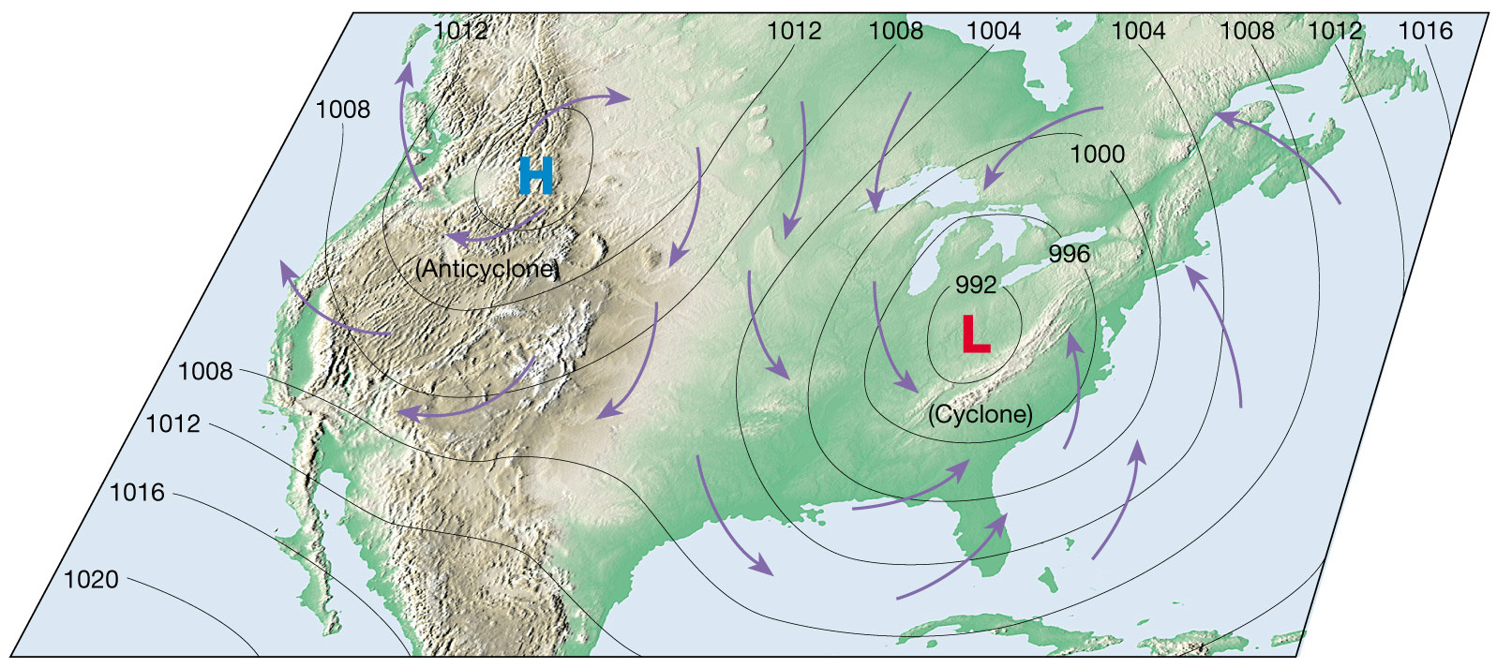
Winds in the N. Hemisphere

Slide 14
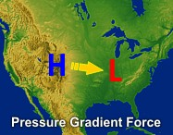
Wind
Caused by horizontal air pressure differences (pressure gradients)
Uneven heating of the Earth creates pressure differences.
What part of the Earth heats up the most?
the equator dummy !!!

Slide 15
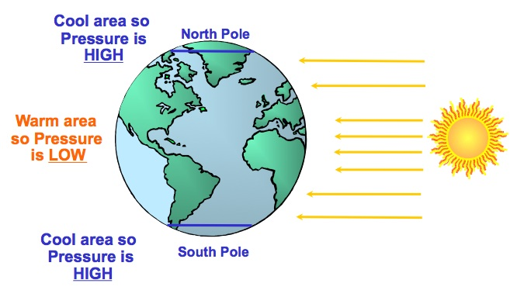
Factors that affect wind:
If the Earth didn’t rotate how would global winds move?
from the poles to the equator
…but the earth DOES rotate so that creates some craziness
Pressure differences = cause air to move
Coriolis Effect = cause winds to be deflected
Friction = slows down air, changes wind direction

Slide 16
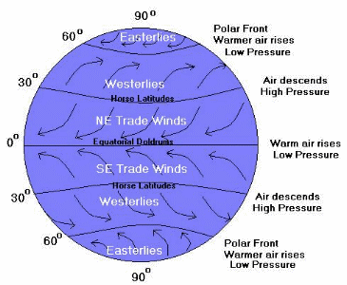
Global Winds
both poles are
high pressure

Slide 17
Air masses
Large body of air that takes on the characteristics of the area over which it forms.
It’s source region determines temperature & humidity.
Air Masses | forms over Land (dry) | forms over Water (humid)
forms near Equator | Continental Tropical (cT) | Maritime Tropical (mT)
forms near Poles | Continental Polar (cP) | Maritime Polar (mP)

Slide 18
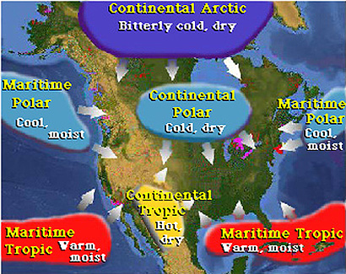

Slide 19
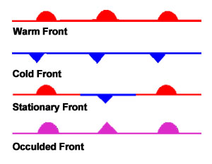
Fronts
Boundary that separates air masses of different densities
Air masses retain their identities
Warm, less dense air forced to move up
Cold, dense air acts as wedge, moving down
4 types:

Slide 20
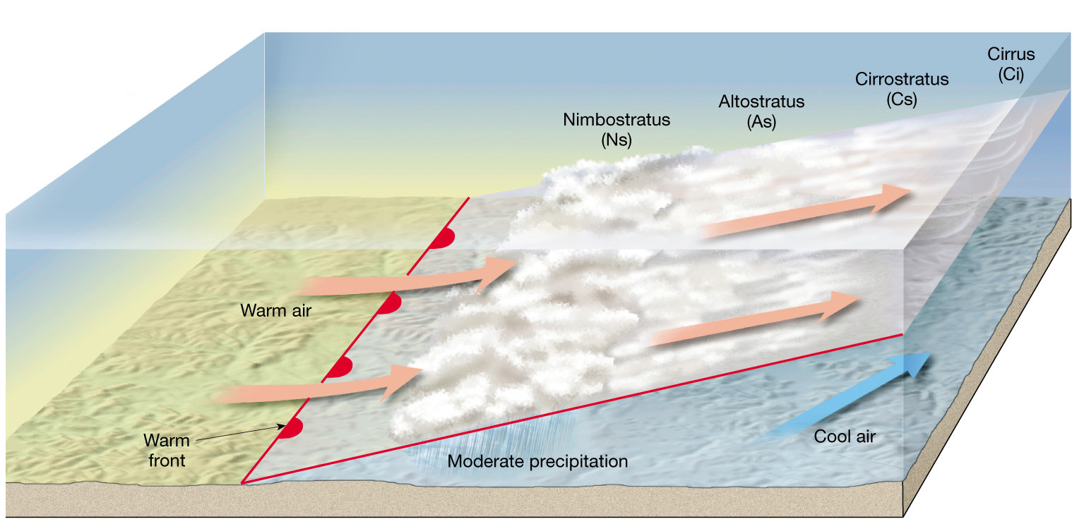
Warm Front
Warm air replaces cooler air
Front is very gentle slope & moves slowly
Light-to-moderate precipitation

Slide 21
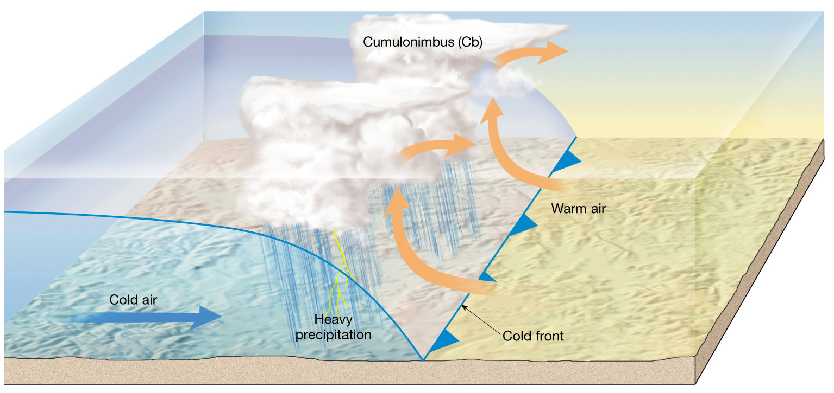
Cold Front
Twice as steep and moves faster than warm front
Violent weather, very intense, & short duration
Weather behind front is cold, sinking air, & clear conditions

Slide 22
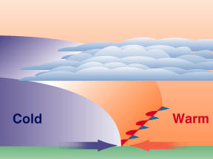
Stationary Front
When 2 air masses meet but don’t advance
Flow of air on both sides of front is parallel
Rarely any clouds or heavy precipitation

Slide 23
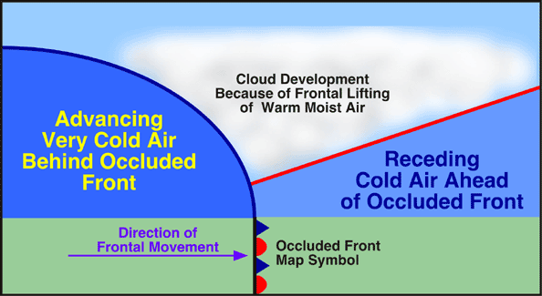
Occluded Front
Occurs when a cold air mass overtakes a warm front
Warm air is wedged upward
Weather is often complex

Slide 24
Cloud Formation

Slide 25
Cloud Formation
Clouds form when warm moist air rises, expands & cools
Condensation nuclei = small particles around which cloud droplets can form
When millions of these droplets collect a cloud forms

Slide 26
Cloud Formation
When a mass of rising air reaches its lifted condensation level(LCL) water vapor condenses into droplets of liquid water or ice
If the density is great enough they become visible in the form of a cloud

Slide 27
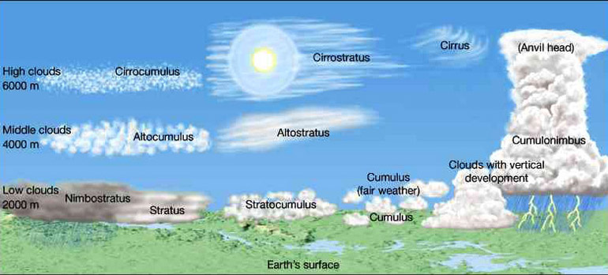
Cloud Classification
Cloud Shapes
Shape | Feature | Shape | Feature
Nimbus | Low, gray rain clouds | Cumulus | Puffy or lumpy
Stratus | Sheets or layers | Cirrus | Thin, wispy, or stringy

Slide 28
Precipitation
When cloud droplets collide they join together to form a larger droplet in a process called coalescence.
As this continues to happen they become to heavy to be held up
When gravity eventually takes over the droplets fall as precipitation
Rain, hail, sleet, snow

Slide 29
Dew Point
Dew point = temperature to which air must be cooled to reach saturation
Saturation = point at which the air holds as much water vapor as it possible can
Condensation = when matter changes from a gas to a liquid

Slide 30
Temperature Change
As air masses move upward they experience a temperature change
An air mass will cool about 10 degrees C for every 1000 meters increase in altitude
When an air mass reaches it’s condensation temperature it is said to have reached its Lifted Condensation Level(LCL)

Slide 31
Humidity
Humidity = amount of water vapor in the air
Relative Humidity = ratio of water vapor in air relative to how much it can hold

Slide 32
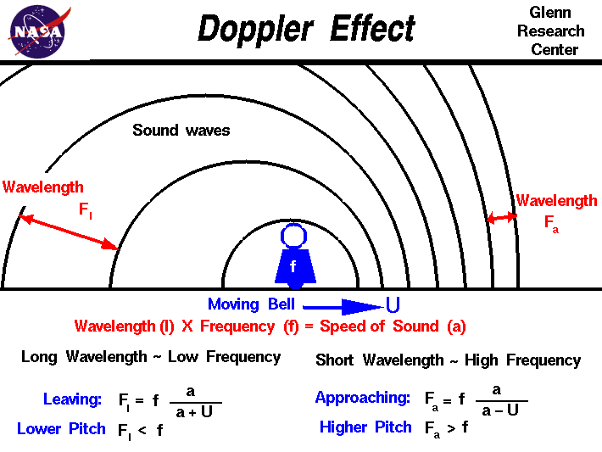
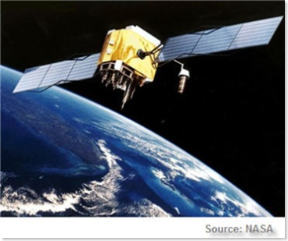
Gathering Weather Data
Thermometer = temperature
Barometer = air pressure
Anemometer = Wind Speed
Hygrometer = relative humidity
Doppler Radar
tracks precipitation & measures wind speeds in storms
uses the Doppler Effect (change in wave frequency)
Satellites
Detects thermal (heat) energy
Gives an image of cloud cover
Determines cloud temperature

Slide 33
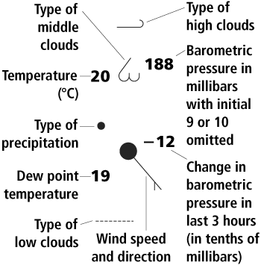
Station Model
A station model is a record of weather data for a specific location and time

Slide 34
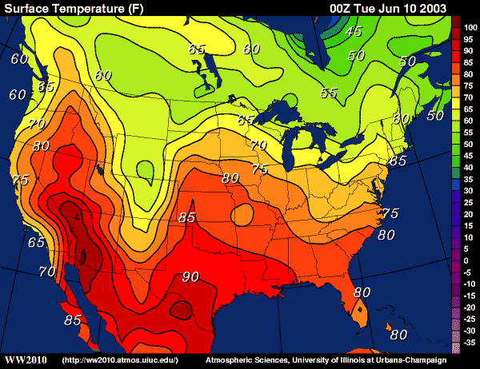
Isotherms = lines that connect areas of equal temperature

Slide 35
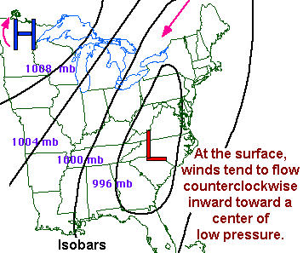

Slide 36
Thunderstorms, Tornadoes, Hurricanes

Slide 37
How do thunderstorms form?
Thunderstorms form when Cumulus clouds grow into cumulonimbus clouds
Cumulus clouds must be lifted
Lower atmosphere must have moisture
Air surrounding the cloud must be cooler than surrounding air

Slide 38
Types of thunderstorms
Air-Mass Thunderstorm-Thunderstorm in which air rises because of unequal heating of Earth’s surface
Sea-Breeze Thunderstorm-Caused by extreme temperature differences between the air over land and the air over water

Slide 39
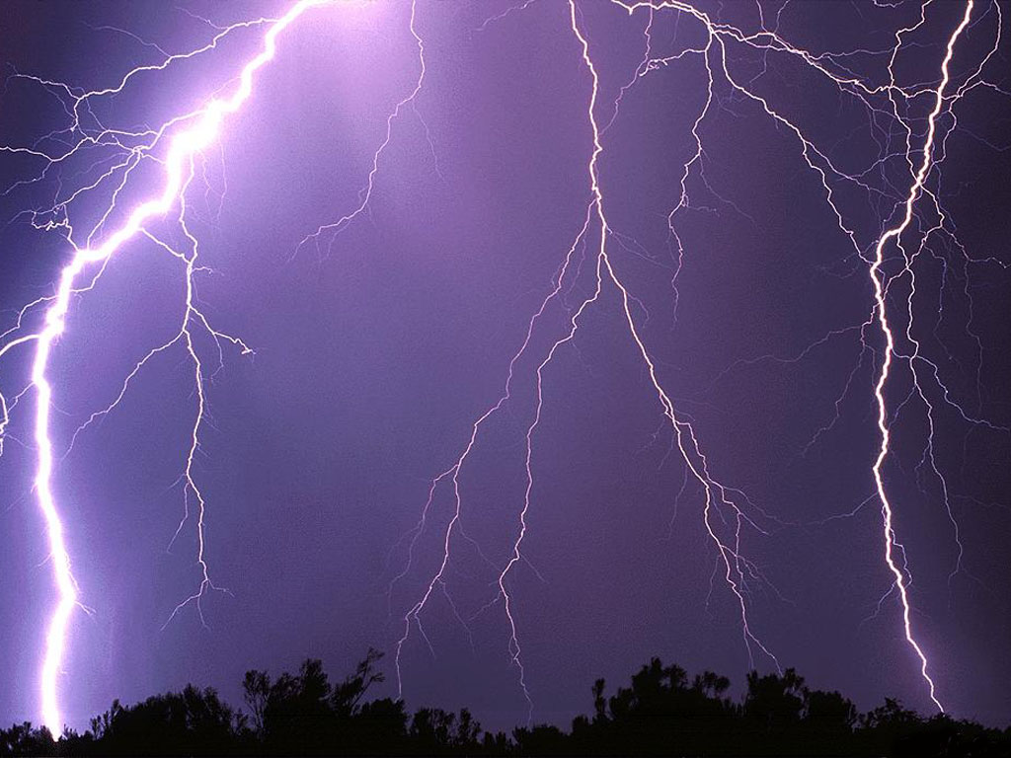
Types of thunderstorms
Types of thunderstorms
Frontal Thunderstorms-Produced by advancing cold fronts and more rarely warm fronts
Frontal Thunderstorms-Produced by advancing cold fronts and more rarely warm fronts

Slide 40
Severe Thunderstorms
The bigger the temperature difference between the upper and lower parts of the storm, the more severe the storm is
They may develop into extremely powerful storms called supercells

Slide 41
Stages of Development
Cumulus Stage-Air rises and forms updrafts which carry moisture to the top. Condensation occurs
Mature Stage-Cool dense air sinks rapidly, produces downdrafts. Convection current
Dissipation Stage-Downdrafts reach the ground, cool and cut off the storms energy supply

Slide 42
Lightning
Lightning is electricity caused by the rapid rush of air in a cumulonimbus cloud
Lightning forms from friction between the updrafts and the downdrafts within a cumulonimbus cloud

Slide 43
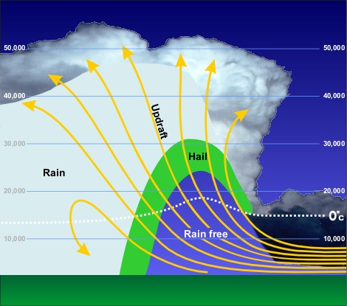
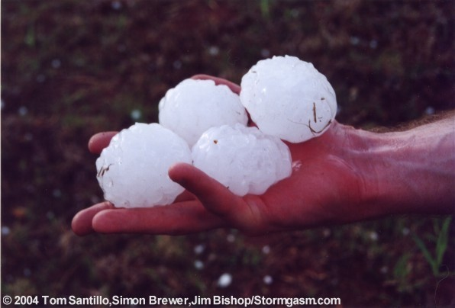
Other Hazards
Hail-Precipitation in the form of balls or lumps of ice
Floods-Floods occurs when a storm dumps its rain over a limited location rather than a large area

Slide 44
Tornados
Tornados are violent, whirling columns of air that are still in contact with the ground
Are often associated with supercells, the most violent thunderstorms
Tornados form when wind speed and direction change suddenly with height and the rotation is tilted from a horizontal to a vertical height

Slide 45
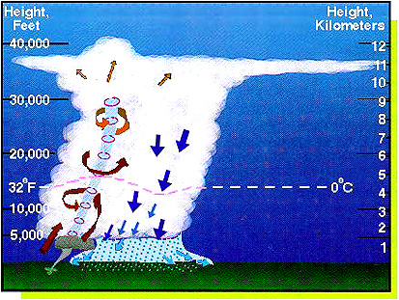

Slide 46
Tornado Classification
Tornadoes are classified according to the Fujita Tornado Intensity Scale
Weak Tornados- F0 and F1
60-115 mph, 1-10 minutes
Strong Tornados-F2 and F3
110-205 mph, 20+ minutes
Violent Tornados-F4 and F5
200 mph +, 1 Hour +

Slide 47
Tropical Storms
Tropical storms are large, rotating, low pressure storms
The strongest of these storms are known as hurricanes

Slide 48
Tropical Storms
Tropical cyclones depend on energy in warm, tropical oceans
As water evaporates from the ocean latent heat is absorbed
This heat is released when air begins to rise and water vapor condenses

Slide 49
Eye
The eye of a hurricane is the center that is relatively calm
The eyewall is the band surrounding the eye that has the strongest winds

Slide 50
Classifying Hurricanes
The Saffir-Simpson hurricane scale classifies hurricanes based on:
Wind speed
Air pressure
Potential for property damage

Slide 51
Classifying Hurricanes
Hurricanes can range from a Category 1(Wind speeds of 74 mph) → Category 5(wind speeds of 155 mph)
Category 3 hurricanes are considered to be major hurricanes

Slide 52
Running out of energy
Hurricanes will last until it can no longer produce enough energy to sustain itself
Usually happens when a hurricane moves over land

Slide 53
Hazards
Storm Surge-Occurs when hurricane force winds drive a mound of ocean water toward coastal areas
Can reach 6 meters above normal sea level

Slide 54
Galveston Hurricane
September 8, 1900-Galveston, Texas
Category 4
Greatest loss of life-6,000-12,000 Deaths
3rd highest number of casualties out of any Atlantic Hurricane
Great Hurricane of 1780
Hurricane Mitch 1998

Slide 55
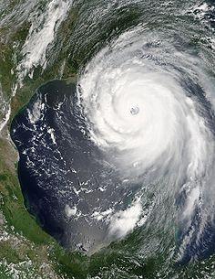
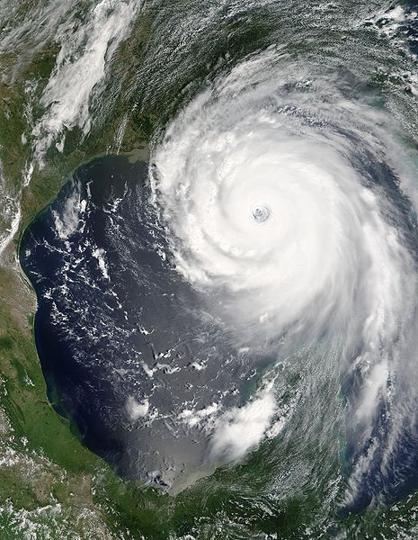
Hurricane Katrina
New Orleans, Louisiana. Category 3 Hurricane
1,836 Deaths, mostly resulted from the levee breaking
Deadliest US Hurricane since 1928

Slide 56
