Slide 1
Warm-up
How many significant figures?
607.0 g
0.020 cm
310 g
Round the following to two sig figs:
25.78 cm
0.007 m
0.100 g
Perform these operations:
15.32 x 74.0092
8.178 / 0.0032
172.8 / 56

Slide 2
Conversions
Whitaker
Unit One, Day Three
28 August 2013

Slide 3
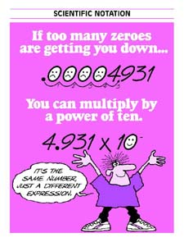
Scientific notation
Really small numbers
Have negative exponents
0.0015 cm = 1.5 X 10 ⁻³
Really large numbers
Have positive exponents
34,500 = 3.45 X 10 ⁴

Slide 4
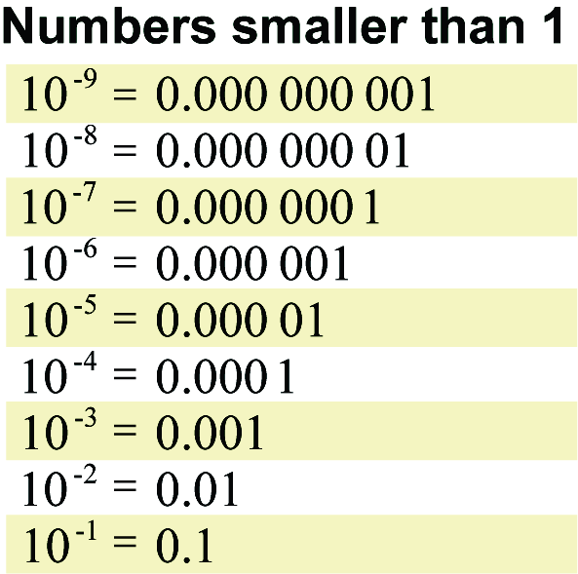

Slide 5
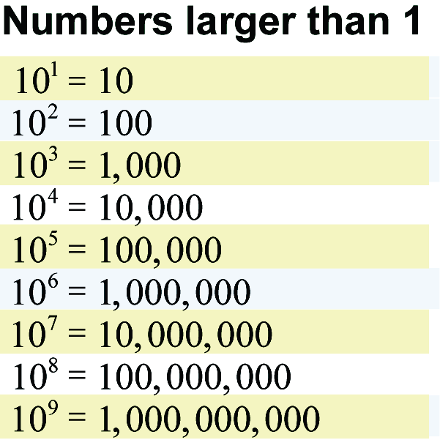

Slide 7
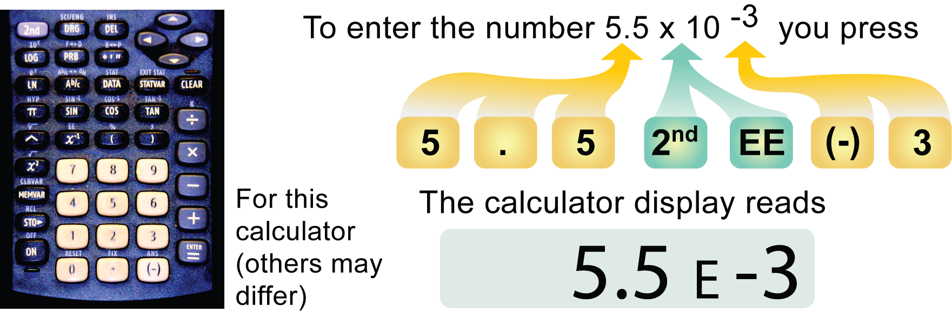

Slide 8
Convert 0.00065 to scientific notation.
Convert 34,500 to scientific notation.

Slide 9
Metric Conversions
Metric Prefix Table
Prefix Symbol Multiplier Exponential
tera T 1,000,000,000,000 10¹²
giga G 1,000,000,000 10⁹
mega M 1,000,000 10⁶
kilo k 1,000 10³
hecto h 100 10²
deca D 10 10¹
Base Unit 1 10⁰
deci d 0.1 10¯¹
centi c 0.01 10¯²
milli m 0.001 10¯³
micro µ 0.000001 10¯⁶
nano n 0.000000001 10¯⁹
pico p 0.000000000001 10¯¹²

Slide 10
Mnemonic Device
The II Great II Monarch II
King Henry Died by drinking chocolate milk
II made II near II poland

Slide 11
Ladder Method
1
2
KILO 1000 Units
3
HECTO 100 Units
DEKA 10 Units
DECI 0.1 Unit
CENTI 0.01 Unit
MILLI 0.001 Unit
Meters Liters Grams
How do you use the “ladder” method?
4 km = _________ m
1st – Determine your starting point.
2nd – Count the “jumps” to your ending point.
3rd – Move the decimal the same number of jumps in the same direction.
Starting Point
Ending Point
How many jumps does it take?
4.
__.
__.
__.
= 4000 m
1
2
3

Slide 12
Conversion Practice
Try these conversions using the ladder method.
1000 mg = _______ g 1 L = _______ mL 160 cm = _______ mm
14 km = _______ m 109 g = _______ kg 250 m = _______ km
Compare using <, >, or =.
56 cm 6 m 7 g 698 mg

Slide 13
More Practice
157,300 nanometers = ________ meters
.00573 Tm = ___________ cm
2574 pm = ____________ mm
.00369 Mm = _____________ dm
6 kilometers = _____________micrometers
3 Gm = _________________ nm

Slide 14
SI Units – standard for metric
Length meter m
Mass kilogram kg
Temperature Kelvin K
Time second s

Slide 15
Ratio Proportions
Look like fractions
Used to change units but not the value
You must have conversion factors to use!

Slide 16
Example:
Convert 4.5 gallons to quarts.
(start with the given)
4.5 gallons
x ------------------- =
How do we pick the conversion factor?
You want it to include both gallons and quarts, if possible.

Slide 17
Convert 4.5 gallons to quarts.
4.5 gallons x quarts
--------------- = ------------------
1 gallon 4 quarts
x = 18 quarts

Slide 18
Sometimes you need 2 conversion factors…
Convert 2.3 weeks to hours.
2.3 weeks X days
------------- = -----------
1 week 1 day
X days X hours
------------- = -----------
1 day 24 hours
386.4 hours

Slide 19
Conversion Practice
1 doc = 17.4 pacs
How many docs do I have if I have 57 pacs?
632 docs = __________ pacs
How many minutes are in a year?

Slide 20
Matter
Anything that has mass and volume
Many different properties are used to describe matter
They can be broken down into two group: physical and chemical properties

Slide 21
Basic definitions – don’t worry, we’re going to look at lots of examples.
Physical Properties
can be observed without changing what the matter is
Chemical Properties
are based on the ability to change into something else

Slide 22
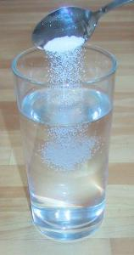
Some examples of physical properties…
Density – mass/volume
Boiling point
Melting point
Solubility – ability of a substance to dissolve
Mass/volume

Slide 23
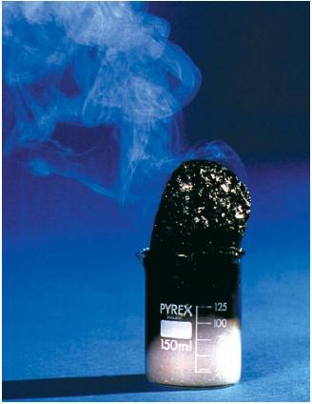
Some examples of chemical properties…
flammability
reactivity

Slide 24
Matter can change.
What are two kinds of change matter can undergo?
Chemical change
Physical change

Slide 25
Two kinds of change…
Chemical change
not reversible
makes a new material
involves a change in energy
Physical change
reversible
changes form, shape or size
still the same material

Slide 26
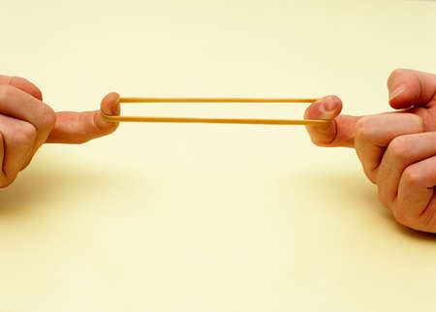
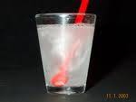
Examples of physical changes…
Physical changes to paper:
Crumple it into a ball
Fold it into small squares
Tear it in half
Other physical changes:
Stretch a rubber band
Dissolve something in water
Change state (solid->liquid->gas)

Slide 27
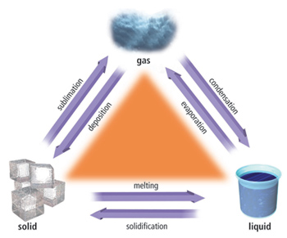
Changes of state are physical changes.

Slide 28
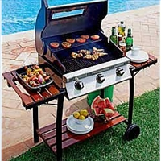
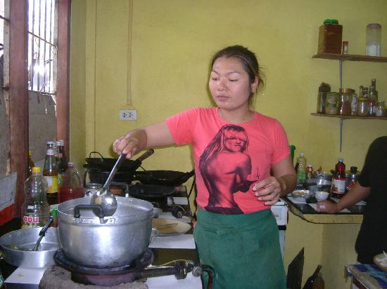
Examples of chemical changes…
Lighting a gas grill
Cooking dinner
Eating dinner

Slide 29
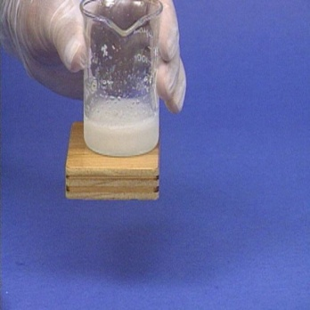
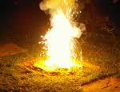
Chemical changes involve
ENERGY
Energy in ←
endothermic
Feels cold, because heat goes from your hand to the reaction.
Energy out →
exothermic
Feels hot, because heat goes from the reaction to your hand.

Slide 30
Indicators of Chemical Changes
Color Change
Gas Produced
Temperature Change
Precipitate Formed

Slide 31
Back to matter
Split up into two different groups:
Pure Substances
Mixtures

Slide 32
Mixtures
Homogeneous – a mixture that is uniform in composition and every part of the solution has same properties
Solutions – special type of homogeneous mixture where different elements are present but are not chemically bonded to each other (example = salt water)
Alloys – metal mixture composed or two or more elements (examples = brass, bronze, pewter, and steel)
Notes:
Homogeneous – air
Solution – salt dissolved in water

Slide 33
Mixtures
Heterogeneous – A mixture that is made up of identifiable parts
- Examples are salad, soil, cereal milk, …

Slide 34
Pure Substances
Two different types:
Elements and Compounds
Elements are found on the periodic table
Compounds are made up of two or more elements
What are some examples of each???

Slide 35
Chemical Reactions
Occur as elements combine to form compounds and compounds break-down into elements
Remember the indicators of chemical change!!
Accompanied with an exchange of energy

