Slide 1
3rd Warm-up
Convert the following into standard notation:
1.54 x 10⁴
6.0 x 10⁻³
Write the following in scientific notation:
1,900,000
0.0000054
Perform the following conversions:
15 cm = ________ m
12 ft = _________ in
0.0045 kg = _________ g

Slide 2
More Conversions!!
Unit One, Day Four
Kimrey
28 January 2013

Slide 3
Matter
Anything that has mass and volume
Density = mass / volume

Slide 4
Matter
Split up into two different groups:
Pure Substances
Mixtures

Slide 5
Mixtures
Homogeneous – a mixture that is uniform in composition and every part of the solution has same properties
Solutions – special type of homogeneous mixture where different elements are present but are not chemically bonded to each other (example = salt water)
Alloys – metal mixture composed or two or more elements (examples = brass, bronze, pewter, and steel)
Notes:
Homogeneous – air
Solution – salt dissolved in water

Slide 6
Mixtures
Heterogeneous – A mixture that is made up of identifiable parts
- Examples are salad, soil, cereal milk, …

Slide 7
Pure Substances
Two different types:
Elements and Compounds
Elements are found on the periodic table
Compounds are made up of two or more elements
What are some examples of each???

Slide 8
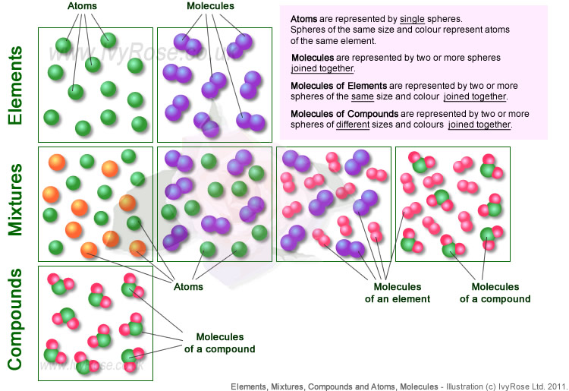

Slide 9
Important Definitions
Atoms – basic unit of matter that consists of a nucleus and is surrounded by electrons
Molecules – a neutral group of two or more ions held together

Slide 10
Matter
Anything that has mass and volume
Many different properties are used to describe matter
They can be broken down into two groups: physical and chemical properties

Slide 11
Basic definitions – don’t worry, we’re going to look at lots of examples.
Physical Properties
can be observed without changing what the matter is
Chemical Properties
are based on the ability to change into something else

Slide 12
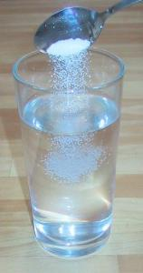
Some examples of physical properties…
Density – mass/volume
Boiling point
Melting point
Solubility – ability of a substance to dissolve
Mass/volume

Slide 13
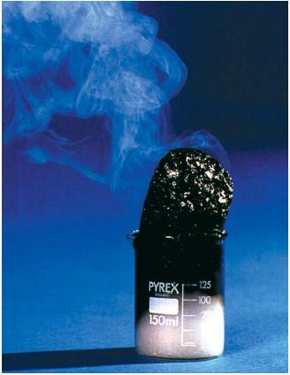
Some examples of chemical properties…
flammability
reactivity

Slide 14
Matter can change.
What are two kinds of change matter can undergo?
Chemical change
Physical change

Slide 15
Two kinds of change…
Chemical change
not reversible
makes a new material
involves a change in energy
Physical change
reversible
changes form, shape or size
still the same material

Slide 16
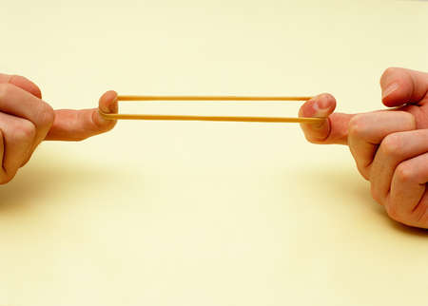
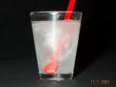
Examples of physical changes…
Physical changes to paper:
Crumple it into a ball
Fold it into small squares
Tear it in half
Other physical changes:
Stretch a rubber band
Dissolve something in water
Change state (solid->liquid->gas)

Slide 17
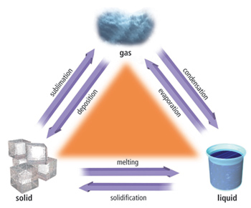
Changes of state are physical changes.

Slide 18
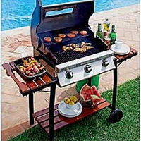
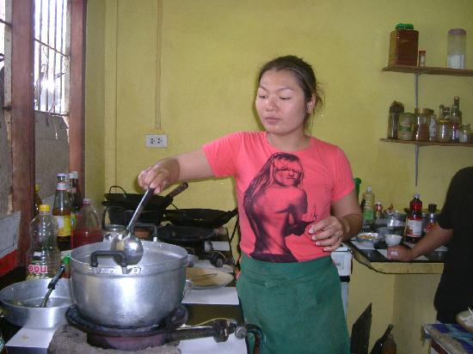
Examples of chemical changes…
Lighting a gas grill
Cooking dinner
Eating dinner

Slide 19
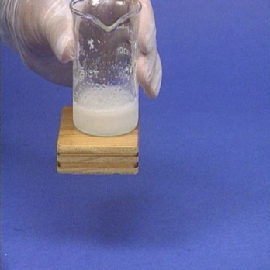
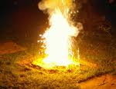
Chemical changes involve
ENERGY
Energy in ←
endothermic
Feels cold, because heat goes from your hand to the reaction.
Energy out →
exothermic
Feels hot, because heat goes from the reaction to your hand.

Slide 20
Indicators of Chemical Changes
Color Change
Gas Produced
Temperature Change
Precipitate Formed

Slide 21
Chemical Reactions
Occur as elements combine to form compounds and compounds break-down into elements
Remember the indicators of chemical change!!
Accompanied with an exchange of energy

