Slide 1
Warm-up
Write names for the following compounds/molecules:
C₂F₆
Pb₂O₃
Write formulas for the following compounds/molecules:
Dinitrogen pentafluoride
Zinc Bromide

Slide 2
Chemistry: Moles!
Unit Five, Day Three

Slide 3
Moles
A mole is simply a unit of measurement
1 mole = 6.02 x 10²³ particles
Particles can be expressed as molecules, ions, or atoms
1 mole = the formula mass (in grams)
The number of particles in a mole is referred to as Avogadro's number

Slide 4
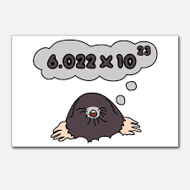

Slide 5
1 mole = the formula mass
Sum of all the atomic masses in a compound
add up the average atomic mass for each atom in the compound
Units are grams per mole
Also called the molar mass

Slide 6
Example
Calculate the molar mass:
H₂O
1.008 + 1.008 + 16 = 18.016g
So, 1 mole of H₂O has a mass of 18.016 grams

Slide 7
Try these
CaCl₂
Mg(OH)₂
NaCl
H₂S
PbCl₂

Slide 8
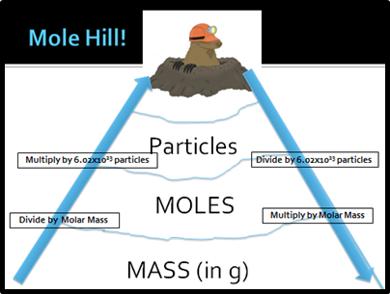
The “Mole Hill”

Slide 9
Mole Conversions
Just use the mole hill!!
Start with the given
Figure out where you need to go.
Solve
Ex. How many moles of water are there in 25.0 grams?
14.2 moles of H₂O = ? Molecules

Slide 10
2 Step Conversions.
Notice on the mole hill there is no way to get to grams from particles directly.
You must go through moles!
Step 1 convert what you have to moles
Step 2 convert moles to what you want.

Slide 11
Example
5o grams of H₂O = ? Molecules
1.6 x 10⁴⁰ molecules of MgCl₂ = ? Grams

Slide 12
Practice
How many grams of NaCl are in 45.3 moles?
How many atoms of Mg in 35.2 grams?
How many moles are in 50.0 grams of oxygen?

