Slide 1
Warm Up
What does VSEPR stand for?
List the five different shapes of molecules.
Predict the shape of the following:
H₂S
O₃
CCl₄

Slide 2
Overall Polarity
Bonding, Day Four
Whitaker
4 October 2013

Slide 3
Remember Polarity??
What do you remember?

Slide 4
Polarity
Polarity is defined as the unequal distribution of electrons.
It can be used in describing of bonds, as we have discussed.
It can also be used to describe an entire molecule.

Slide 5
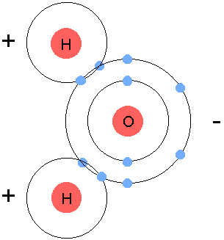
Polar molecules have a slightly positive end and a slightly negative end.

Slide 6
How do you know if a molecule is polar?
Bent, and trigonal pyramidal molecules are ALWAYS polar.
Tetrahedral, trigonal planar, and linear can also be polar IF and ONLY IF there are different elements.
Ex. CH₂F

Slide 7
If there are lone pairs then it’s polar!!

Slide 8
Examples
Determine if the following molecules are polar or non-polar. To do this, draw the Dot Diagram and determine the shape!
CH₄
NH₃
H₂O
CSeF₂
CO₂

Slide 9
More Practice!
Determine if the molecule is polar or non-polar:
NH₃
HCl
O₂
CHF₃
OF₂

Slide 10
Types of Intermolecular Forces
Hydrogen bonding
Dipole-Dipole
London Dispersion Forces

Slide 11
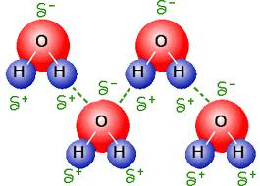
Hydrogen Bonding
The strongest of the intermolecular forces.
Between hydrogen and oxygen, hydrogen and fluorine, or hydrogen and nitrogen atoms from different molecules
It’s an electrostatic attraction, not a true chemical bond
Very important in water!

Slide 12
Dipole-Dipole
Attractive forces between the positive end of one polar molecule and the negative end of another polar molecule

Slide 13
London Dispersion
Also called induced dipole
Between non-polar molecules
Very very weak

Slide 14
So, intermolecular forces summary
Hydrogen bonds are the strongest
Then comes dipole-dipole interactions
And the weakest intermolecular forces are London Dispersion forces

Slide 15
Strength of Bonds
Non-polar bonds are the weakest
Then come polar
And the strongest bonds are ionic
Triple bonds are stronger than double bonds and double bonds are stronger than single bonds (but ionic is stronger than all of them!)
Bond strength is measured by boiling points and melting points
the stronger the bond, the higher the melting point.

Slide 16
Properties of Ionic Compounds
Ionic bonds are the strongest!!
Composed of positive and negative ions
Form between a metal and a non-metal or a metal and a polyatomic ion
Are all solids
When bonded, they are arranged very neatly – become crystals
High melting points and boiling points
Brittle
Conduct electricity when dissolved in water

Slide 17
Properties of Covalent Compounds
Smallest unit is a molecule
May be solid, liquid, or gas
Low melting point
High to low solubility in water – depending on polarity
Covalent solids are softer than ionic solids
Non-polar compounds do not dissolve in water
Polar compounds dissolve in water and don’t conduct electricity
Examples:
Sugar
Wax
Alcohol
Iodine

Slide 18
Properties of Metallic Compounds
Shiny
Malleable
Ductile
Crystalline
Solid at room temperature (except for Hg)
Melting points vary widely
Good conductors of heat and electricity

