Slide 1
Warm-up
Remember the three different intermolecular forces we discussed (look back in your notes if you don’t remember).
What are the three types?
How do you know which type is present in a molecule?
Look at the two formulas on the board. Which intermolecular forces are present?

Slide 2
Warm Up
What are some properties of solids that you can think of?
What are some properties of liquids that you can think of?
What are some properties of gasses that you can think of?

Slide 3
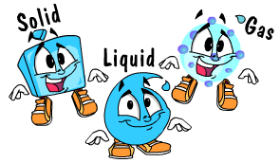
States of Matter
Unit 8, Day 1

Slide 4
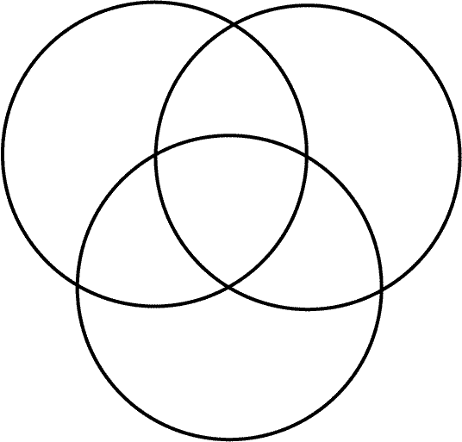
Venn Diagram

Slide 5
Properties of a solid
Not compressible
Rigid
Definite Shape and volume
No Diffusion

Slide 6
Properties of Liquids
Not compressible
Fluid
Definite volume
No Definite Shape
Diffusion

Slide 7
Properties of Gasses
Compressible
No definite shape or volume
Diffusion

Slide 8
What happens when states change…
Solids can become liquids and liquids can become gases.
As a substance changes from one state to another it must gain or lose energy.
Solids – lowest kinetic energy
Liquids – medium kinetic energy
Gases – highest kinetic energy

Slide 9
Adding Energy to a solid.

Slide 10
What happens when you heat a substance?
Two possible things happen:
The substance changes temperature
The substance changes state of matter
Note: It is only one of the above, NEVER both at one time.
This can be represented by a heating curve.

Slide 11
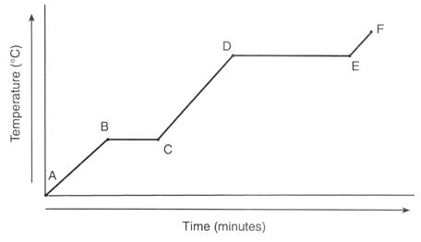
Heating Curves
A graphical representation of the temperature and energy involved in heating a substance.

Slide 12
When a substance changes temperature.
Specific Heat = The amount of energy required to raise the temperature of 1 gram of a substance by 1°C.
Note! Every substance has a unique specific heat.
q=mcΔT

Slide 13
q=mcΔT
q = heat absorbed or released (most often in Joules)
m = mass of the sample in grams
c = the specific heat of the substance (J/g°C)
ΔT = the change in temperature in degrees Celsius
When solving a word problem, start by writing down your givens and figuring out what you are looking for. Then solve for the variable.

Slide 14
Example
How many joules of heat are needed to raise the temperature of 10.0 g of aluminum from 22°C to 55°C, if the specific heat of aluminum is 0.90 J/g°C?

Slide 15
Example
Calculate the heat capacity of a piece of wood if 1500.0 g of the wood absorbs 6.75×10⁴ joules of heat, and its temperature changes from 32°C to 57°C

Slide 16
Example
To what temperature will a 50.0 g piece of glass raise if it absorbs 5275 joules of heat and its specific heat capacity is 0.50 J/g°C? The initial temperature of the glass is 20.0°C.

