Slide 1
Warm-up – Don’t forget tomorrow’s quiz!!
How much heat is needed to turn 15 grams of ice at -50°C to water at 95 °C?
Givens for water:
Hv = 2260 J/g
Hf = 334 J/g
C_{solid} = 2.05 J/g°C
C_{liquid} = 4.18 J/g°C
C_{gas} = 2.02 J/g°C

Slide 2
Pressure and Gas Laws
Unit 8, Day 4

Slide 3
Pressure
What is pressure?
Pressure is the force a substance exerts on an object.
Caused by the collisions that occur between the molecules and the object.
Can be measured in atmospheres (atm), Pascals (Pa), millimeters of mercury (mmHg), or pounds per square __________.

Slide 4
How does pressure affect the state of matter.
Pressure affects the state of matter in addition to the temperature.
Increasing or decreasing the pressure will change a substance’s melting/boiling point.
To see how it will alter the melting/boiling point, we use a phase change diagram.

Slide 5
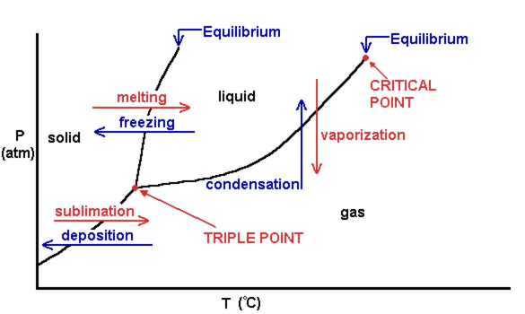
Phase Change Diagram

Slide 6
Definitions
Triple Point = the temperature and pressure where all three phases of the substance coexist in equilibrium
Critical Point = the point at where distinctions between the liquid and gas phases no longer exist

Slide 7
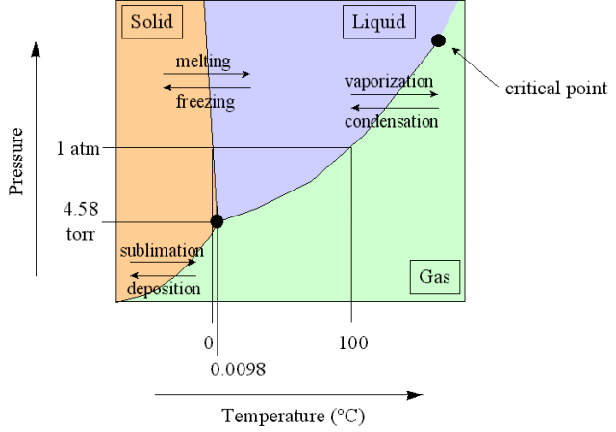
Example
In what state of matter will water exist at 1.5 atm and 100°C?

Slide 8
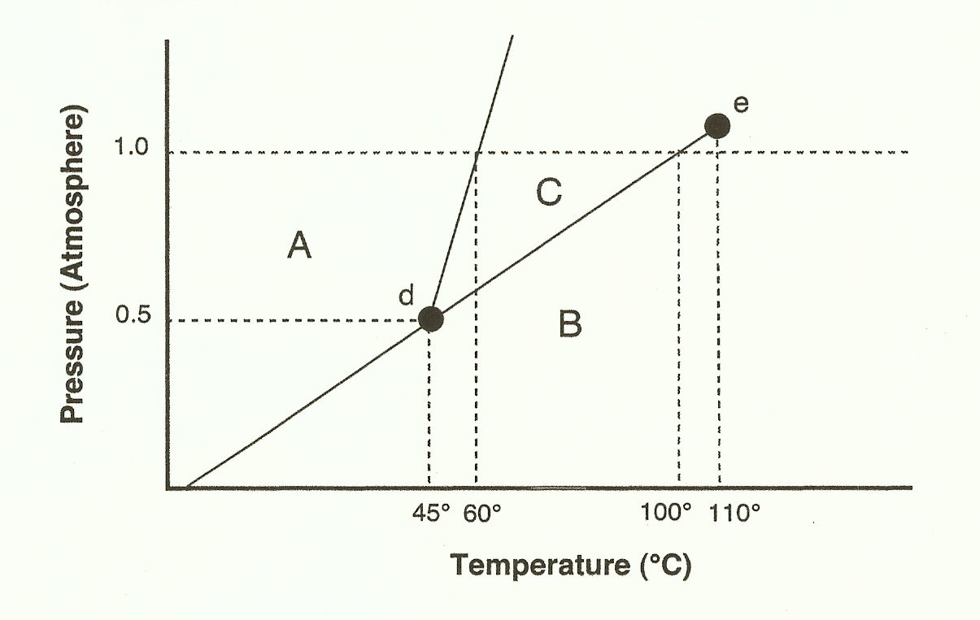
What is the boiling point of this substance at 0.75 atm?
What letter represents the critical point?
What is special at the triple point?

Slide 9
Warm-up – Don’t forget tomorrow’s quiz!!
How much heat is needed to turn 15 grams of ice at -50°C to water at 95 °C?
Givens for water:
Hv = 2260 J/g
Hf = 334 J/g
C_{solid} = 2.05 J/g°C
C_{liquid} = 4.18 J/g°C
C_{gas} = 2.02 J/g°C

Slide 10
Quick Practice for tomorrow
If you increase the pressure from .5 atm to 1 atm, what happens to the boiling point? The melting point?

Slide 11
Gas Laws Part One
Unit 8, Day 4

Slide 12
Remember the Properties of Gases
Have a Mass
Are compressible
Fill empty space completely
Diffuse rapidly
Exert pressure

Slide 13
Conversion Factors for Pressure
These are listed on your reference table, so you won’t have to remember them on a test!
1.00 atm = 101.3 kPa = 760. mmHg = 760. torr
kPa means kiloPascals, so you may have to convert from Pascals into kiloPascals. Don’t ever forget your metric conversions!!!

Slide 14
Example
A barometer shows the pressure to be 785 mmHg. What is the atmospheric pressure in atmospheres? Pascals?
1.032 atm
104.632 kPa
104,632 Pa

Slide 15
Gas Law
A way to measure quantitatively the relationship between pressure, volume, and temperature
Using these relationships, we can solve equations for unknowns of a gas!

Slide 16
Gas Law
P = Pressure
V = Volume
T = Temperature
1 shows the initial conditions
2 shows the final conditions

Slide 17
Units
Temperature must be in Kelvin
Degrees Celsius plus 273 = Temperature in Kelvin
You don’t even have to remember this! The reference tables show that 0 °C is the same as 273K
Pressure can be in whichever unit you want, as long as you keep it in that unit (this means the unit of P₁ must be the same as the unit of P₂)!
Volume must be the same on each side.
MAKE SURE YOU’RE PAYING ATTENTION TO THE UNITS!

Slide 18
Example
A gas at 285 K, 5 atm, and 25 mL is cooled to 225 k and a volume of 15 mL. What is the new pressure?
6.579 atm

Slide 19
The three laws
If you hold one of the three variables constant, then we can see how a change of one will effect another.
You don’t have to remember these three, but it is important to understand the relationships between the variables!

Slide 20
Volume is held constant
Pressure and temperature are directly proportional.
This means that, if volume is held constant and pressure is increased, temperature will increase as well.

Slide 21
Temperature is held constant
Volume and pressure are inversely related.
This means that, if temperature is held constant and pressure goes up, volume goes down.
P₁V₁=P₂V₂

Slide 22
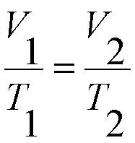
Pressure is held constant
Volume and temperature are directly proportional.
This means that, when pressure is held constant, increasing volume will also increase temperature

Slide 23
Example
A gas at 335 K and 1 atm is cooled to 285 K. What is the new pressure?

Slide 24
Example
A gas at 4.00 atm and in a 20 mL container is moved to a container with a volume of 30 mL. What is the new pressure?

Slide 25
Example
A gas at 305 K and 35 mL is heated to 400 k. What is its new volume?

