Slide 1
Warm-up
Predict the following products and then balance the reactions
K₂SO₄ + HgCl₂ →
C₆ H₁₄O₄ + O₂ →
AgOH →
N₂ + Ca →

Slide 2
Net Ionic Equations and Energy in Reactions
Unit 6, Day 6

Slide 3
Writing the Net Ionic equation
You almost know how to do this!
Start with the completely balanced equation.
Look at the solid product and make it the product of your Net Ionic equation.
For the reactants, put the ions that lead to the product

Slide 4
Examples
Na₂SO₄ + CaCl₂ → 2NaCl + CaSO₄
SO₄²⁻_{(aq)}+ Ca²⁺_{(aq)}→CaSO_{4 (s)}
3NaOH + FeCl₃ → 3NaCl + Fe(OH)₃
3OH⁻_{(aq)} + Fe³⁺_{(aq)} → Fe(OH)_{3 (s)}

Slide 5
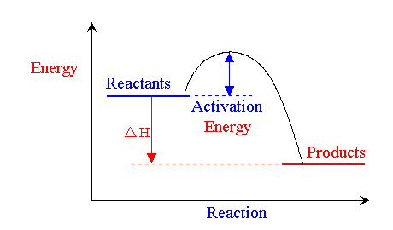
Energy in reactions!!!

Slide 6
The Collision Theory
States that atoms, ions, and molecules must collide in order to react.
The reacting substances must collide with each other with the correct orientation.
And, reacting substances must collide with sufficient energy to form the product(s).

Slide 7
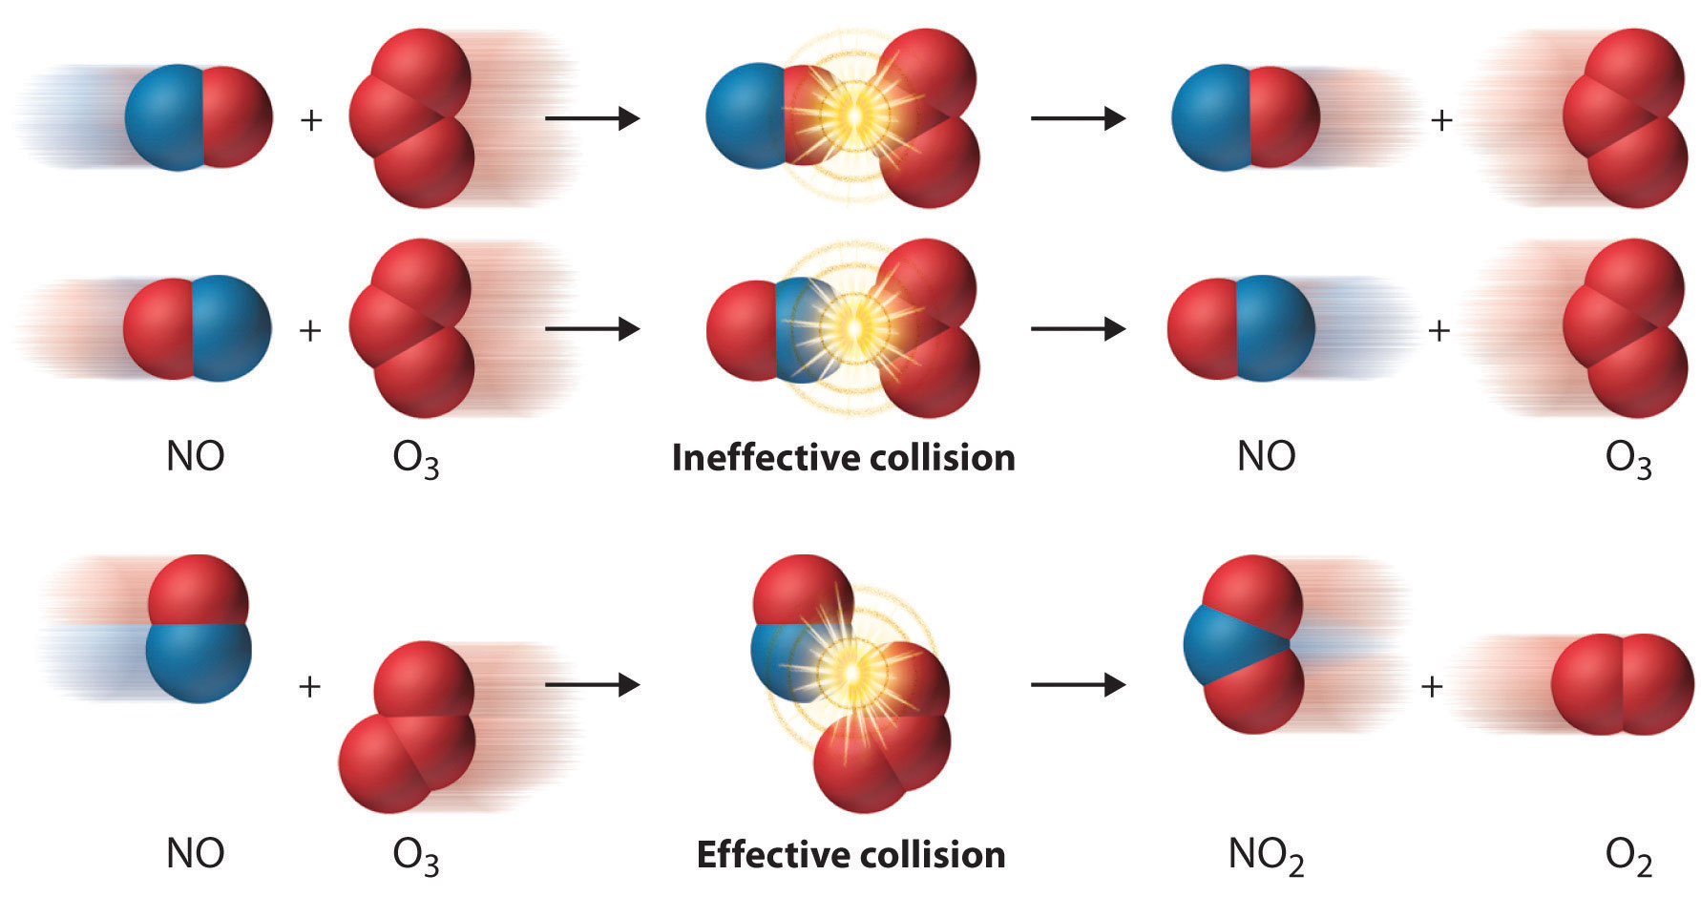

Slide 8
Activation Energy
Activation energy is the energy required to start a reaction.
Abbreviated as E_{a}

Slide 9
Reaction Rates
The time that it takes for reactions to occur
There are four factors that affect reaction rates

Slide 10
Concentration of the Reactants
A higher concentration means that there are more particles
Since particles must collide in order to react, more particles means a higher probability that they will line up and collide properly
So, increasing concentration increases the rate of reaction

Slide 11
Surface Area
Grinding a substance is one way to increase its reaction rate. This is because, for the same mass, many small particles possess more total surface area than one large particles.
Increasing surface area doesn’t change concentration but does increase the rate of collision between reacting particles.
Increasing surface area increases reaction rate

Slide 12
Temperature
Increasing temperature increases the average kinetic energy of the particles.
So, reacting particles collide more frequently at higher temperatures than at lower temperatures.
Increasing temperature increases the reaction rate

Slide 13
Catalysts
A catalyst is a substance that increases the rate of a chemical reaction without itself being consumed in the reaction.
Catalysts do not change the reactants or the products but they do decrease the activation energy.
Adding a catalyst will increase the reaction rate

Slide 14
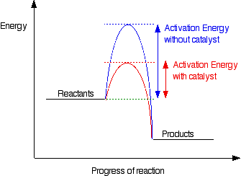

Slide 15
Energy
Energy can be either released or absorbed in a reaction.
Endothermic: Energy is absorbed and cold.
Exothermic: Energy is released and is hot.

Slide 16
Endo vs. Exo
So, if a reaction is endothermic and energy is absorbed, energy is taken in as a reactant.
If a reaction is exothermic, energy is given off as a product.

Slide 17
Ca_{(s)} + FeO _{(aq)} → ∆H + Cr(NO₃)_{2(aq)} + Pb_{(s)}
∆H + 3NaOH + FeCl₃ → 3NaCl + Fe(OH)₃

Slide 18
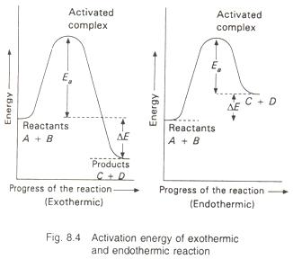
Energy vs. Reaction Progress Graphs

