Slide 1
Warm-up
You will need a periodic table today!!
How many electrons are in the following?
O-2
K+1
Ne
Ca+2

Slide 2
Chemistry
Unit Three, Day Four

Slide 3
Quantum Numbers
Numbers used to describe where the electron is in the atom
There are four different quantum numbers
Today, we’re going to focus on the first two

Slide 4
Principle Quantum Number (n)
Tells the energy level of the electron
Numbers 1 through 7
1 – smallest orbital, closest to nucleus, lowest energy ☺
7 – largest orbital, farthest from nucleus, highest energy ☹

Slide 5
Orbital Quantum Number (l)
Tells the shape of the orbital
Also called a sublevel
s – sphere shaped
Exists on every energy level (1-7)
p – peanut shaped
Only exists on energy levels 2-7
d – daisy shaped
Only exists on energy levels 3-7
f – “funky”
Only exists on energy levels 4-7

Slide 6
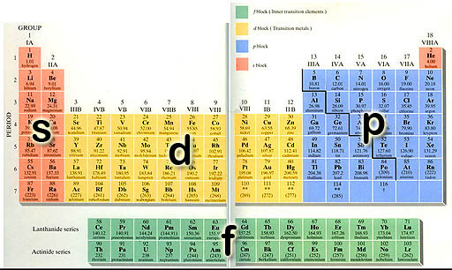
Energy levels based on location

Slide 7
How many electrons can fit in each sublevel?
The s sublevel can hold up to 2 electrons
The p sublevel can hold up to 6 electrons
The d sublevel can hold up to 10 electrons
The f sublevel can hold up to 14 electrons

Slide 8
Electrons will completely fill up the first sublevel they get to before moving on to the next one
Electrons like to be close to the nucleus
Remember the hotel… the boys don’t want to have to climb the stairs

Slide 9
Electron Configuration
All of this will help us to write the electron configuration for elements
EACH ELECTRON MUST BE ACCOUNTED FOR!!
So, it is extremely important that you know how to determine how many electrons are present in a specific isotope. If you’re still struggling with this, you’ll be getting lots of practice in the next few days, don’t worry.

Slide 10
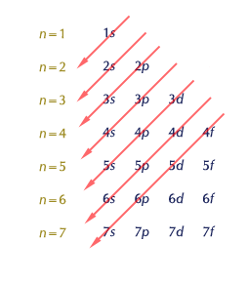
The diagonal rule

Slide 11
Practice
Let’s start with Hydrogen.
Has only 1 electron (in its neutral state)
The electron must be in the orbital closest to the nucleus.
That orbital is number 1
The only sublevel in the first orbital is s
H 1s¹

Slide 12
Helium isn’t much more difficult
Has 2 electrons
The electrons must be in the orbital closest to the nucleus.
That orbital is number 1
The only sublevel in the first orbital is s
He 1s²

Slide 13
A little tougher…
Lithium
Has 3 electrons
Only 2 can fit in an s sublevel, so the first orbital is filled with the first two electrons
The one that’s left has to move to the second orbital (since only two electrons are allowed in the first)
It goes in the first sublevel there
Li 1s²2s¹

Slide 14
Let’s do a harder one
Oxygen
First, how many electrons?
How many can go in the first orbital, and what sublevel are they in?
Now, how many can fit in the second orbital?
How many of those go in the first (s) sublevel?
How many are left and which sublevel are they in?
O 1s²2s²2p⁴

Slide 15
Lots of practice!!!
Nitrogen
Calcium
Fluorine
Sulfur
Sodium
1s²2s²2p³
1s²2s²2p⁶3s²3p⁶4s²
1s²2s²2p⁵
1s²2s²2p⁴3s²3p⁴
1s²2s²2p⁴3s¹

Slide 16
Now, look at Manganese
How many electrons???
Mn 1s²2s²2p⁶3s²3p⁶4s²3d⁵

Slide 17
More Practice
Y
Se
Rb
Ge
Ar

Slide 18
Noble Gas Configuration
Write out the e⁻ configuration for Beryllium and Helium.
Short Cut!!!!!
Write the element symbol.
Write the symbol of the noble gas before your desired element in [ ].
Pick up the e⁻ configuration after the noble gas.

Slide 19
Example
What is the noble gas notation of calcium?

Slide 20
You Try
Write the noble gas notations for the following:
Cl
F
I

Slide 21
Valence Electrons
Valence electrons: the electrons in the highest energy level that are responsible for bonding and forming ions.
Write out the e⁻ configuration and add up those that are in the highest energy level.

Slide 22
Example
How many valence electrons in Magnesium?

Slide 23
You Try
Determine the number of valence electrons for:
C
B
Si

Slide 24
Lewis Dot Diagrams
Visually expresses the number of valence electrons.
Write the symbol for the element
Pretend the symbol is in a box and draw a dot each line for every valence electron.

Slide 25
Example
Draw the Lewis dot structure for Oxygen.

Slide 26
You try
Write the Lewis dot diagrams for the following:
Ca
Si
Fe

