Slide 1
Warm Up
Give an example of a polar substance.
What are the two main types of mixtures and what are examples of each of them?? (HINT: they both start with “H”)

Slide 2
Solutions
Day 1

Slide 3
Remember mixtures?
A mixture contains two or more pure substances. Mixtures can be any combination of solids, liquids, and gases (Breads are mixtures of yeast, flour, sugar, water, air, and other chemicals)

Slide 4
Matter (Solid, Liquid, Gas)
Pure Substances
You can only see one thing because there is only one kind of particle in it.
Mixtures
- Made up of at least two parts
Heterogeneous Mixture
- can see individual parts
Homogenous/Solutions
They’re mixed together so well you only see one thing – it looks pure but it isn’t
A solute is the substance to be dissolved (sugar).
The solvent is the one doing the dissolving (water).

Slide 5
What is a solution?
A solution is a homogeneous mixture that contains a solute and a solvent.
Solute- what you’re dissolving (the smaller amount)
Solvent- what you’re using to dissolve (the bigger amount)

Slide 7
Example
Identify the solute and solvent in:
50 grams of sugar and 300 grams of water
600 moles of water and 200 moles of ethanol
67 moles of zinc and 100 moles of copper
25 grams of salt and 500 grams of water

Slide 8
Quick Review
Can you see two parts in solutions or are they mixed together so well you only see one thing?
you only see one thing
Are solutions mixtures or pure substances?
Mixtures
What kind of states can a solution be?
Solid, liquid, or gas
What are the two “s” words that every solution must have?
A solute and a solvent

Slide 9
More important definitions
Soluble - when a substance has the ability to dissolve in a substance.
Insoluble - when a substance cannot dissolve in a substance.
Miscible - soluble
Immiscible - insoluble

Slide 10
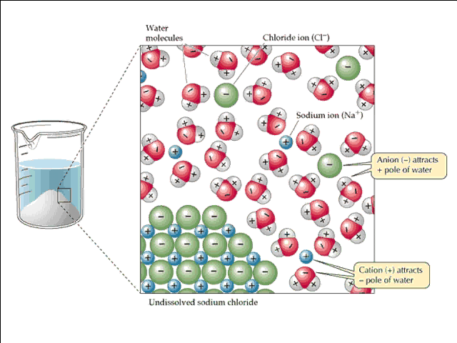
What happens at the molecular level?
When you throw a handful of salt in a glass of water it undergoes solvation.
Solvation- process of surrounding solute particles with solvent particles.

Slide 12
Factors that affect rate of solvation
Stirring
Temperature
Surface Area

Slide 13
Solubility
Solubility- maximum amount of solute that will dissolve at a given temp and pressure.

Slide 14
Temp and solubility
Generally speaking:
Ionic Salts are more soluble as temp increases.
Gases are less soluble as temp increases.

Slide 15
Pressure
Only affect gases.
As pressure increases solubility increases.
Think about carbonated drinks!!

Slide 16
Types of solutions
Unsaturated- can hold more solute
Saturated- is full of solute
Supersaturated- holds more solute than it should
The type of solution can be determined by solubility curves.

Slide 17
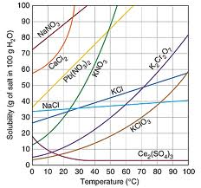
Solubility Curves

Slide 18
Example
How many grams of KCl can dissolve in 100 g of water at 70°C?
About 48 g

Slide 19
Example
What type of solution exists when I dissolve 50 grams of KNO₃ in 100 g of water at 80°C?
Unsaturated

Slide 20
Example
At what temperature will I have a saturated solution of NaCl by dissolving 40 g in 100 g of water?
90 °C

Slide 21
Exit Card
Define solute and solvent
Identify the solute and solvent in 56 g of ethanol and 10 grams of water
What is a super saturated solution?

Slide 22
Describing Solutions
Molarity (M) – a mathematical expression for how concentrated a solution is

Slide 23
Example
Calculate the molarity of a solution prepared by dissolving 4.56 grams NaOH into enough water to make a 56.78 mL solution.

Slide 24
You try!
What is the concentration of a HBr solution if the volume of the solution is 1000 mL and 5.6 moles HBr are used to make the solution?
How many moles of HCl are needed to make 45 mL of a 6 molar solution?

Slide 25
Dilution
A solution can be diluted by adding more solvent to a solution.
M₁V₁ = M₂V₂

Slide 26
Example
What volume of 12 M hydrochloric acid is needed to make 15 mL of a 4.5 M solution?

