Slide 1
Worksheet – Earthquake P-wave & S-wave Travel Time Chart Tutorial

Slide 2
1) If you are asked the travel time of a P-wave or S-wave for a given epicenter distance:
a) Go to the epicenter distance on the x-axis and go up to the correct curve,
b) Go over to the y-axis and determine the travel time.
Example 1: How long does it take a P-wave to travel 4,000 km?
Answer: 7 minutes

Slide 3
1) If you are asked the travel time of a P-wave or S-wave for a given epicenter distance:
a) Go to the epicenter distance on the x-axis and go up to the correct curve,
b) Go over to the y-axis and determine the travel time.
Example 2: How long does it take an S-wave to travel 4,000 km?
Answer: 12 min 40 sec

Slide 4
1) If you are asked the travel time of a P-wave or S-wave for a given epicenter distance:
a) Go to the epicenter distance on the x-axis and go up to the correct curve,
b) Go over to the y-axis and determine the travel time.
Example 3: How long does it take a P-wave to travel 8,000 km?
Answer: 11 min 20 sec

Slide 5
1) If you are asked the travel time of a P-wave or S-wave for a given epicenter distance:
a) Go to the epicenter distance on the x-axis and go up to the correct curve,
b) Go over to the y-axis and determine the travel time.
Example 4: How long does it take an S-wave to travel 8,000 km?
Answer: 20 min 40 sec

Slide 6
2) If you are asked for the epicenter distance a P-wave or S-wave traveled for a given travel time:
a) Go to the travel time on the y-axis and go over to the correct curve,
b) Go down to the x-axis to determine the epicenter distance.
Example 5: How far can an S-wave travel in 9 minutes?
Answer: 2,600 km

Slide 7
2) If you are asked for the epicenter distance a P-wave or S-wave traveled for a given travel time:
a) Go to the travel time on the y-axis and go over to the correct curve,
b) Go down to the x-axis to determine the epicenter distance.
Example 6: How far can an P-wave travel in 9 minutes?
Answer: 5,600 km

Slide 8
2) If you are asked for the epicenter distance a P-wave or S-wave traveled for a given travel time:
a) Go to the travel time on the y-axis and go over to the correct curve,
b) Go down to the x-axis to determine the epicenter distance.
Example 7: How far can an S-wave travel in 6 minutes 40 seconds?
Answer: 1,800 km

Slide 9
2) If you are asked for the epicenter distance a P-wave or S-wave traveled for a given travel time:
a) Go to the travel time on the y-axis and go over to the correct curve,
b) Go down to the x-axis to determine the epicenter distance.
Example 8: How far can a P-wave travel in 6 minutes 40 seconds?
Answer: 3,700 km

Slide 10
3) If you are asked for the arrival time of an earthquake wave and given an epicenter distance and origin time:
a) Determine travel time of the wave (see #1)
b) Add travel time to the origin time given.
Example 9: If an earthquake occurs at 08:50:40, what time did the P-wave arrive at a seismic station 2,600 km away?
08:50:40
+00:05:00
Answer: 08:55:40

Slide 11
3) If you are asked for the arrival time of an earthquake wave and given an epicenter distance and origin time:
a) Determine travel time of the wave (see #1)
b) Add travel time to the origin time given.
Example 10: If an earthquake occurs at 02:11:20, what time did the S-wave arrive at a seismic station 9,000 km away?
02:11:20
+00:22:20
Answer: 02:33:40

Slide 12
4) If you are asked for the origin time (the time an earthquake occurred):
a) Determine the travel time of the given wave (see #1)
b) Subtract arrival time you were given minus the travel time.
Example 11: If a P-wave arrives at a station 8,000 km away at 12:15:00, what time did the earthquake originate?
12:15:00
- 00:11:20
Answer: 12:03:40

Slide 13
4) If you are asked for the origin time (the time an earthquake occurred):
a) Determine the travel time of the given wave (see #1)
b) Subtract arrival time you were given minus the travel time.
Example 12: If an S-wave arrives at a station 4,400 km away at 07:45:00, what time did the earthquake originate?
07:45:00
- 00:13:40
Answer: 07:31:20

Slide 14
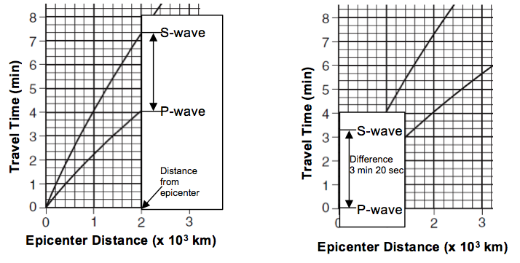
5) If you are asked to determine the difference in arrival time between P-waves and S-waves:
Line up a piece of scrap paper vertically on the epicenter distance given.
Mark the locations where the P-wave and S-wave intersect your scrap paper.
Line up the scrap paper on the y-axis with one point on the 0 minute mark.
The second mark will indicate the difference in arrival time.

Slide 15
5) If you are asked to determine the difference in arrival time between P-waves and S-waves:
Line up a piece of scrap paper vertically on the epicenter distance given.
Mark the locations where the P-wave and S-wave intersect your scrap paper.
Line up the scrap paper on the y-axis with one point on the 0 minute mark.
The second mark will indicate the difference in arrival time.
Example 13: An epicenter station is 5,000 km away. How long after the first P-wave did the first S-wave arrive?

Slide 16
5) If you are asked to determine the difference in arrival time between P-waves and S-waves:
Line up a piece of scrap paper vertically on the epicenter distance given.
Mark the locations where the P-wave and S-wave intersect your scrap paper.
Line up the scrap paper on the y-axis with one point on the 0 minute mark.
The second mark will indicate the difference in arrival time.
Example 13: An epicenter station is 5,000 km away. How long after the first P-wave did the first S-wave arrive?
Answer: 6 min 40 sec

Slide 17
5) If you are asked to determine the difference in arrival time between P-waves and S-waves:
Line up a piece of scrap paper vertically on the epicenter distance given.
Mark the locations where the P-wave and S-wave intersect your scrap paper.
Line up the scrap paper on the y-axis with one point on the 0 minute mark.
The second mark will indicate the difference in arrival time.
Example 14: An epicenter station is 7,600 km away. How long after the first P-wave did the first S-wave arrive?

Slide 18
5) If you are asked to determine the difference in arrival time between P-waves and S-waves:
Line up a piece of scrap paper vertically on the epicenter distance given.
Mark the locations where the P-wave and S-wave intersect your scrap paper.
Line up the scrap paper on the y-axis with one point on the 0 minute mark.
The second mark will indicate the difference in arrival time.
Example 14: An epicenter station is 7,600 km away. How long after the first P-wave did the first S-wave arrive?
Answer: 9 min 0 sec

Slide 19
6) If you are asked to determine the arrival time of the S-wave and given a clock time for the arrival of the P-wave:
Find difference in arrival time between P-wave and S-wave at the given epicenter distance.
Add the difference in arrival time to the clock time of the P-wave.
Example 15: A P-wave arrived at a seismic station 3,200 km away at 06:10:00. What time did the first S-wave arrive at this station?

Slide 20
6) If you are asked to determine the arrival time of the S-wave and given a clock time for the arrival of the P-wave:
Find difference in arrival time between P-wave and S-wave at the given epicenter distance.
Add the difference in arrival time to the clock time of the P-wave.
Example 15: A P-wave arrived at a seismic station 3,200 km away at 06:10:00. What time did the first S-wave arrive at this station?
06:10:00
+ 00:04:40
Answer: 06:14:40

Slide 21
6) If you are asked to determine the arrival time of the S-wave and given a clock time for the arrival of the P-wave:
Find difference in arrival time between P-wave and S-wave at the given epicenter distance.
Add the difference in arrival time to the clock time of the P-wave.
Example 16: A P-wave arrived at a seismic station 4,000 km away at 01:25:00. What time did the first S-wave arrive at this station?

Slide 22
6) If you are asked to determine the arrival time of the S-wave and given a clock time for the arrival of the P-wave:
Find difference in arrival time between P-wave and S-wave at the given epicenter distance.
Add the difference in arrival time to the clock time of the P-wave.
Example 16: A P-wave arrived at a seismic station 4,000 km away at 01:25:00. What time did the first S-wave arrive at this station?
01:25:00
+ 00:05:40
Answer: 01:30:40

Slide 23
7) If you are asked to determine the arrival time of the P-wave and given a clock time for the arrival of the S-wave:
Find difference in arrival time between P-wave and S-wave at the given epicenter distance,
Subtract the difference in arrival time from the clock time of the S-wave.
Example 17: An S-wave arrived at a seismic station 6,200 km away at 04:48:00. What time did the first P-wave arrive at this station?

Slide 24
7) If you are asked to determine the arrival time of the S-wave and given a clock time for the arrival of the P-wave:
Find difference in arrival time between P-wave and S-wave at the given epicenter distance.
Add the difference in arrival time to the clock time of the P-wave.
Example 17: An S-wave arrived at a seismic station 6,200 km away at 04:48:00. What time did the first P-wave arrive at this station?
04:48:00
- 00:07:40
Answer: 04:40:20

Slide 25
7) If you are asked to determine the arrival time of the P-wave and given a clock time for the arrival of the S-wave:
Find difference in arrival time between P-wave and S-wave at the given epicenter distance,
Subtract the difference in arrival time from the clock time of the S-wave.
Example 18: An S-wave arrived at a seismic station 1,400 km away at 09:20:40. What time did the first P-wave arrive at this station?

Slide 26
7) If you are asked to determine the arrival time of the S-wave and given a clock time for the arrival of the P-wave:
Find difference in arrival time between P-wave and S-wave at the given epicenter distance.
Add the difference in arrival time to the clock time of the P-wave.
Example 18: An S-wave arrived at a seismic station 1,400 km away at 09:20:40. What time did the first P-wave arrive at this station?
09:20:40
- 00:02:20
Answer: 09:18:20

Slide 27
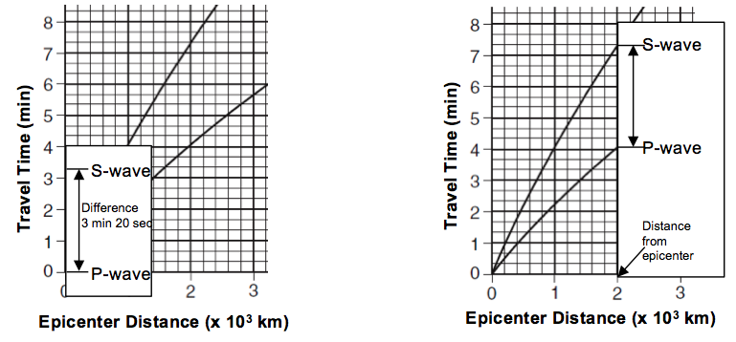
8) If you are asked to determine the epicenter distance using the difference in arrival time of P-wave and S-wave:
Find the difference in clock time between the P-wave and S-wave by subtracting the given times.
Use the Y-axis (time travel) and use a piece of scrap paper to mark the time difference.
Place the marked scrap paper between the P-wave and S-wave line on the graph. Slide the scrap paper along the graph to find the location that the interval is touching both P-wave and S-wave line.
Determine the epicenter distance of this location using the X-axis.

Slide 28
8) If you are asked to determine the epicenter distance using the difference in arrival time of P-wave and S-wave:
Find the difference in clock time between the P-wave and S-wave by subtracting the given times.
Use the Y-axis (time travel) and use a piece of scrap paper to mark the time difference.
Place the marked scrap paper between the P-wave and S-wave line on the graph. Slide the scrap paper along the graph to find the location that the interval is touching both P-wave and S-wave line.
Determine the epicenter distance of this location using the X-axis.
Example 19: The first P-wave arrived at a seismic station at 10:00:00. The first S-wave arrived at the same seismic station at 10:08:40. How far is this seismic station from the epicenter?
10:08:40
- 10:00:00
00:08:40

Slide 29
8) If you are asked to determine the epicenter distance using the difference in arrival time of P-wave and S-wave:
Find the difference in clock time between the P-wave and S-wave by subtracting the given times.
Use the Y-axis (time travel) and use a piece of scrap paper to mark the time difference.
Place the marked scrap paper between the P-wave and S-wave line on the graph. Slide the scrap paper along the graph to find the location that the interval is touching both P-wave and S-wave line.
Determine the epicenter distance of this location using the X-axis.
Example 19: The first P-wave arrived at a seismic station at 10:00:00. The first S-wave arrived at the same seismic station at 10:08:40. How far is this seismic station from the epicenter?
Answer: 7,200 km

Slide 30
8) If you are asked to determine the epicenter distance using the difference in arrival time of P-wave and S-wave:
Find the difference in clock time between the P-wave and S-wave by subtracting the given times.
Use the Y-axis (time travel) and use a piece of scrap paper to mark the time difference.
Place the marked scrap paper between the P-wave and S-wave line on the graph. Slide the scrap paper along the graph to find the location that the interval is touching both P-wave and S-wave line.
Determine the epicenter distance of this location using the X-axis.
Example 20: The first P-wave arrived at a seismic station at 06:32:20. The first S-wave arrived at the same seismic station at 06:34:20. How far is this seismic station from the epicenter?
06:34:20
- 06:32:20
00:02:00

Slide 31
8) If you are asked to determine the epicenter distance using the difference in arrival time of P-wave and S-wave:
Find the difference in clock time between the P-wave and S-wave by subtracting the given times.
Use the Y-axis (time travel) and use a piece of scrap paper to mark the time difference.
Place the marked scrap paper between the P-wave and S-wave line on the graph. Slide the scrap paper along the graph to find the location that the interval is touching both P-wave and S-wave line.
Determine the epicenter distance of this location using the X-axis.
Example 20: The first P-wave arrived at a seismic station at 06:32:20. The first S-wave arrived at the same seismic station at 06:34:20. How far is this seismic station from the epicenter?
Answer: 1,200 km

